Slide 1
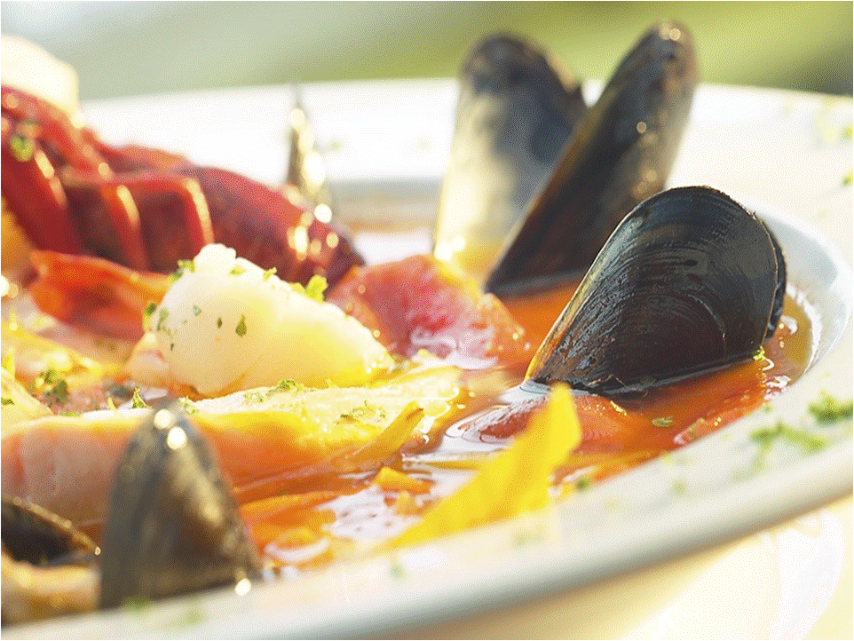

Slide 2
A Balanced Diet
Presented by:
Mr. Ajith K K
Asst. Professor
College of Nursing Kishtwar

Slide 4
What is a Balanced Diet?
Do the people in your family have different dietary needs?
The amount of nutrients we need depend on our:
Age
Sex
Health
Occupation
Levels of activity.
A balanced diet provides the correct amount of nutrients that a person needs.
We do not all need the same amount.

Slide 5
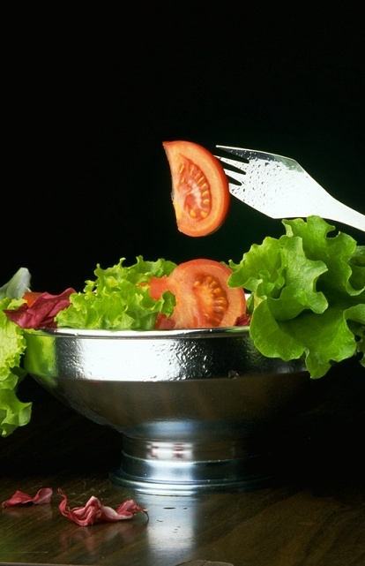
Nutrients in Food
It does have minerals inc. calcium, magnesium and potassium.
To follow a balanced diet you need to know what nutrients are found in each food item.
Nutrition tables, computer nutritional analysis programs and food labels can help.
Would eating this salad give you a balanced meal?
This salad has only 8kcal.
It has only traces of fat, carbohydrate and protein.
It has minerals and trace elements.
It has trace elements like zinc, copper, iron and selenium.

Slide 6
Dietary Reference Values
Dietary reference values are a guide to what energy and nutrients a person needs.
DRV’s include figures for people with:
Low needs
Average requirements

Slide 7
Saturates <11% of food energy
Sugar <11% of food energy
Fat <35% of food energy
18g of fibre
300g of carbohydrate
225g of carbohydrate
56g of protein
46g of protein
2500 kcal of energy
2000 kcal of energy

Slide 8
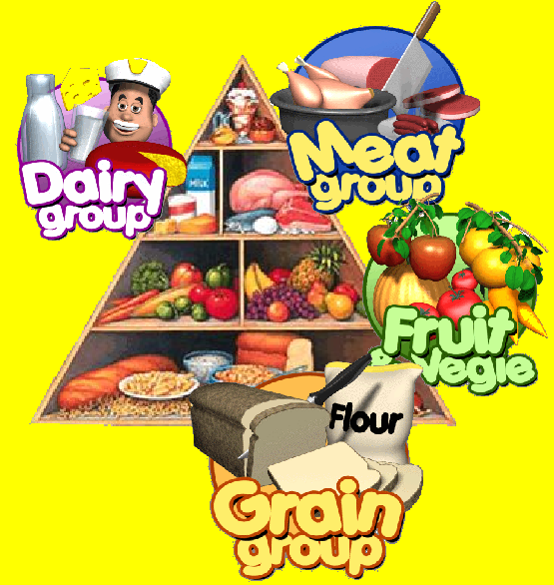
The Balance of Good Health
The pyramid shows how a balanced diet should be made up.
This is based on The National Food Guide 1994 to help people follow a good overall diet.
Each section shows how much of each type of food we should have.
Notice the sugars and fats at the top are a small portion.
The grains are by far the largest group.

Slide 9
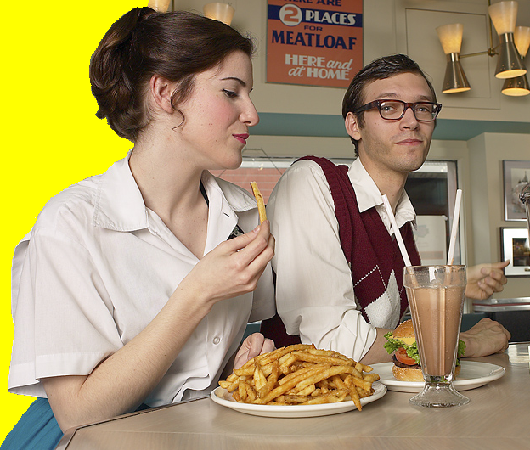
Adapting Food
Cook the chips in olive oil
Current dietary guidelines tell us to:
Eat more carbohydrates
Eat more fibre
Eat more fruit and vegetables
Eat less fat, salt and non-milk extrinsic sugars.
How could you adapt this burger meal to make it more healthy?
Drink water or fruit juice
Use low fat cheese
Add extra vegetables or salad
Don’t add salt
Make the shake from low fat milk

Slide 10
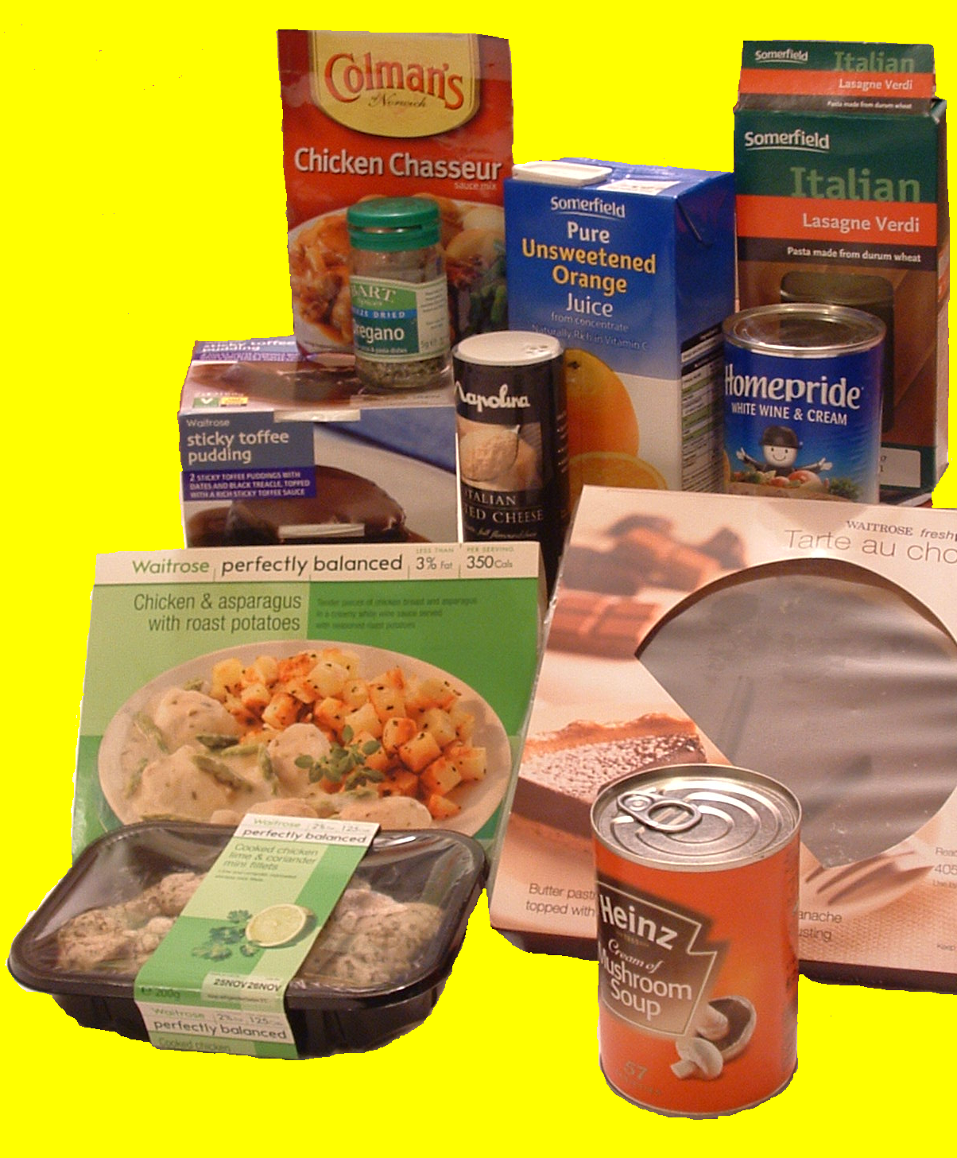
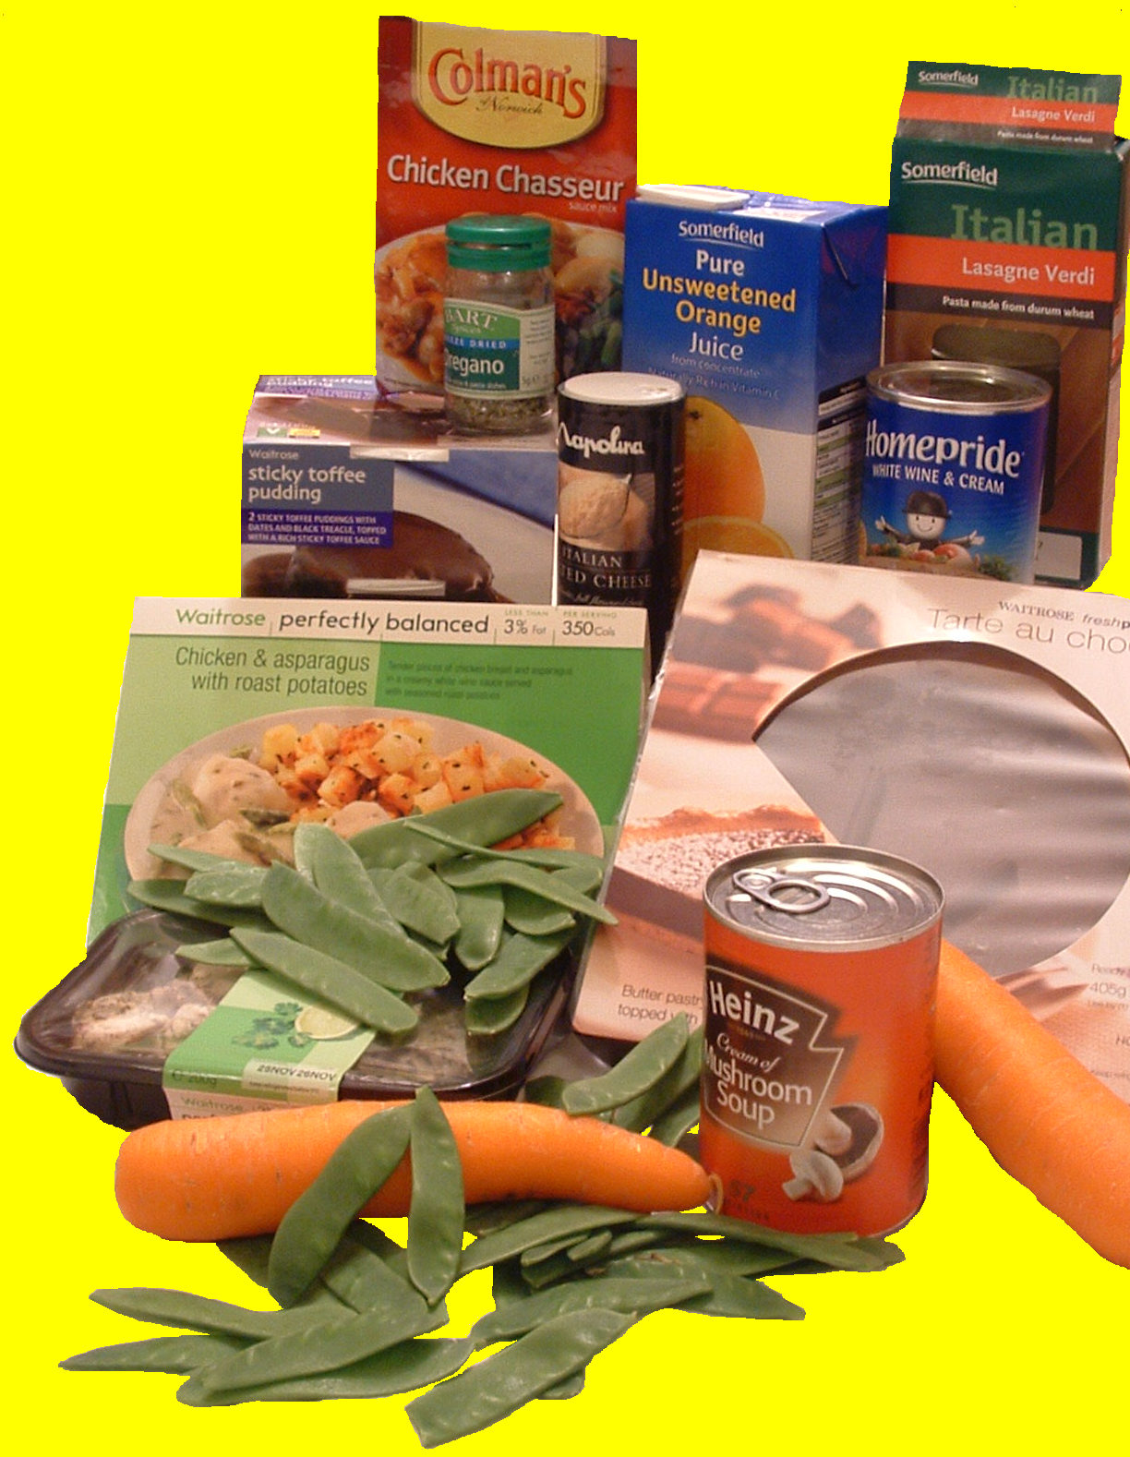
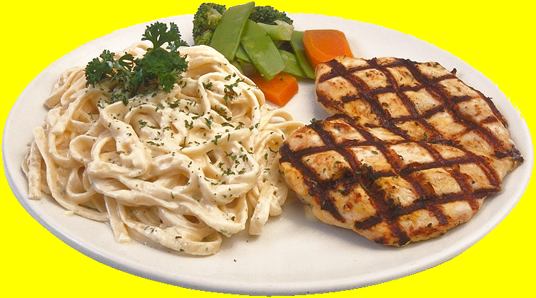
Using Convenience Food
Today’s lifestyle means that you will probably use convenience foods.
You might have:
Ready-prepared meals
Canned foods
Bottled and canned sauces
Dehydrated foods like pasta
Dried food mixes like herbs
Cartons of drink
Frozen and cook-chill foods.
These combined with fresh food like vegetables make interesting nutritious meals.
Notes:
^*#{}#*^
SHOW tom, tom.acs, 42, 68
PLAY Wave
PLAY LookLeft
PLAY GestureLeft
SAY Convenience foods are ^EMPHASIS^very popular. ^PAUSE=1300^
PLAY Confused
SAY They seem to have a bad reputation! ^PAUSE=600^
PLAY Point45
SAY Convenience foods do not need to be bad for you! ^PAUSE=300^
PLAY Explain
SAY Many people want something quick to eat when they get in from work. ^PAUSE=1300^
PLAY HandsOnHips
SAY They may be going out again^PAUSE=300^ so they do not want to spend their spare time preparing food. ^PAUSE=1300^
PLAY Gestureleft
SAY As long as we choose convenience meals carefully and we combine convenience elements with other fresh foods we can produce quick ^PAUSE=300^ nutritious meals. ^PAUSE=1300^
PLAY Explain
SAY Food technology has had an impact on how we eat,^EMPHASIS^especially with cook-chill meals which are cooked, ^PAUSE=200^ chilled quickly ^PAUSE=200^ and then kept cold.
PLAY Explain2
SAY Then there are ready meals that are cooked and packed before being stored at room temperature. ^PAUSE=1300^
PLAY Explain
SAY There are different ways of preparing convenience foods.
PLAY Blink
SAY Some are ready to eat from the container and need ^EMPHASIS^no cooking,
PLAY Blink
SAY some need heating only and some need cooking completely. ^PAUSE=300^
PLAY Confused
SAY Some are part of a meal like a sauce. ^PAUSE=1300^
PLAY Explain
SAY A visit to the supermarket will show you how many convenience foods there are!^PAUSE=1300^
PLAY Pleased
PLAY Wave
END

Slide 11
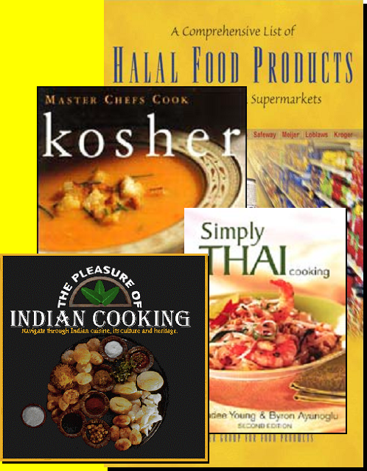
Multicultural Food
Meal planning will depend on religious beliefs.
Many religions have forbidden foods.
Other foods used in different parts of the world have also filtered into the eating habits of the UK general population.
One example of this is the Mediterranean diet.

Slide 12
Thank You

