Slide 1
BASAL METABOLIC RATE
Presented by,
Ajith K K
Asst. Prof
Nursing college kishtwar

Slide 2
Energy
Energy is the capacity to do work. We need energy for :
Basal Metabolism
Basal Metabolic Rate- BMR: energy required for activity of the internal organs and maintaining of body temperature.
Physical Activity
Metabolizing of Food

Slide 3
Calorie: unit used to measure energy
Kilocalorie is a unit of energy commonly used to express energy value of food.
Food energy is the amount of energy in food that is a available through digestion. The energy value of food indicates its value to the body as fuel.

Slide 4
Kilocalories come from foods and beverages
Bomb calorimeter used in laboratories to measure kilocalories in foods and beverages
Results must be adjusted for the physiological fuel values
Nutrition analysis software or food composition tables can estimate energy in
Carbohydrate and Protein: 4 kcal/gram
Fat: 9 kcal/gram
Alcohol: 7 kcal/gram

Slide 5
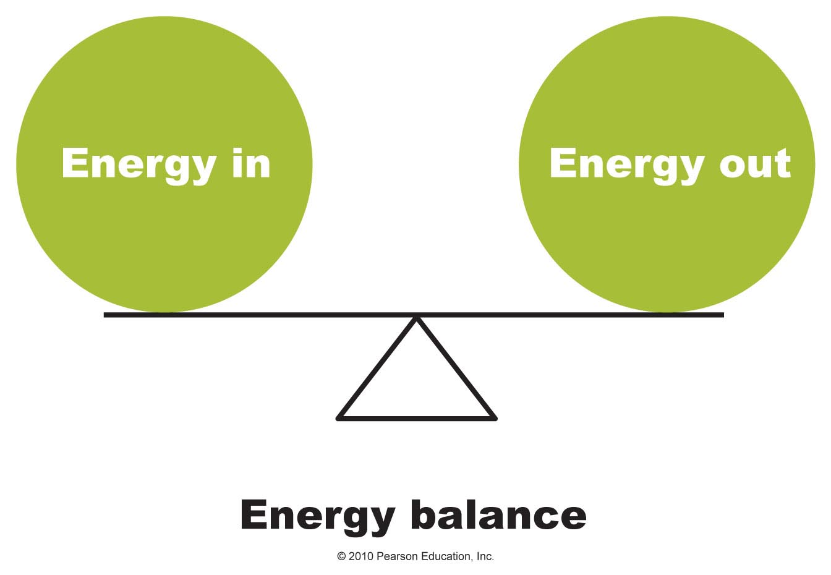
What Is Energy Balance and Why Is It Important?
Energy balance is achieved when the kilocalories consumed equal the kilocalories expended

Slide 6
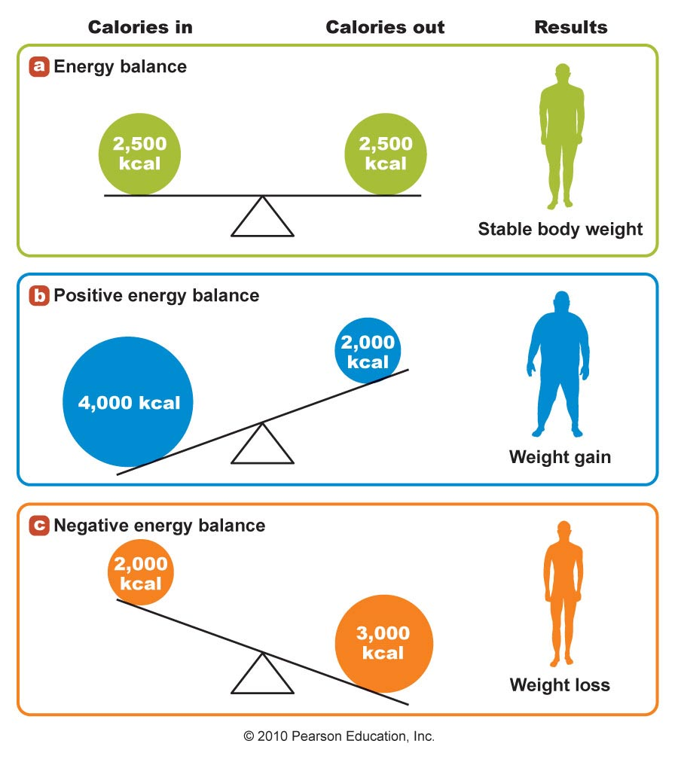
The Concept of Energy Balance

Slide 7
The Basal Metabolic Rate
Keeping your Basal Metabolic Rate (BMR) as high as possible is vital when it comes to weight loss and maintaining healthy body fat levels

Slide 8
Factors that Affect Basal Metabolic Rate
Exercise: This is one of the biggest factors that influence BMR.
BMR is higher in people who exercise regularly

Slide 9
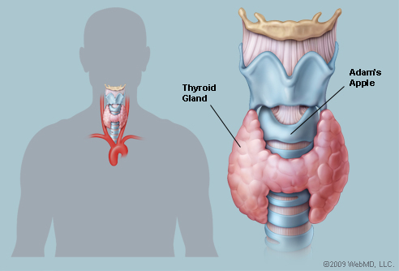
Hormones: an increase in thyroid hormones increases BMR, decreased levels of the hormone lower BMR
Body Temperature: Excessive heat or cold raise BMR

Slide 10
Gender: Males tend to have higher basal metabolism than females due to an abundance of hormones such as testosterone ad elevated levels of muscle mass compared to females
Age: as we get older basal metabolic rate becomes increasingly slower.

Slide 11
Surface Area: Taller individuals have a higher BMR compared to shorter individuals. More surface area means more heat lost from the body, which causes the metabolism to speed up in order to maintain body temperature.

Slide 12
Stress and Illness: increase in hormone activity due to physical or physiological stress increase BMR.
Starvation: Fasting for more than 48 hrs. will lead to a decrease of 50% of Basal Metabolic Rate.

Slide 14
Health Risks Associated with Body Weight and Body Composition
Being overweight increases health risks
Overweight and obesity associated with increased risk of heart disease, hypertension, stroke, hyperlipidemia, gallstones, sleep apnea, and reproductive problems
Increases risk of certain cancers including colon, breast, endometrial, and gallbladder cancer
More than 80% of people with type 2 diabetes are overweight
Metabolic syndrome is associated with central obesity

Slide 15
Health Risks Associated with Body Weight and Body Composition
Being underweight also increases health risks
Symptomatic of malnutrition, substance abuse, or disease
Higher risk of anemia, osteoporosis and bone fractures, heart irregularities, and amenorrhea
Correlated with depression and anxiety, inability to fight infection, trouble regulating body temperature, decreased muscle strength, and risk of premature death
May be unintentional and due to malabsorption associated with diseases such as cancer, inflammatory bowel disease, or celiac disease

