Slide 1
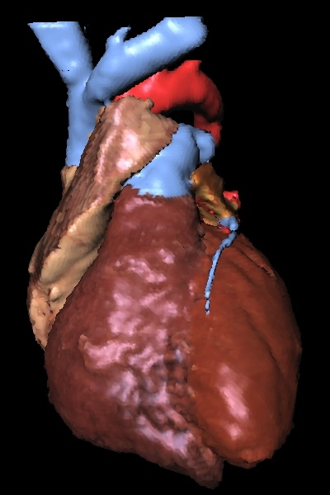
CARDIAC CYCLE
PRESENTED BY,
BINCY CHERIAN
ASST. PROF
Nursing College Kishtwar

Slide 2
1 - Sinoatrial node (SA node)
2 - Atrioventricular node (AV node)
3 – Bundle of His
4 - Right & Left Bundle Branches
which lead to Purkinje Fibers

Slide 3
Circulation

Slide 4
CARDIAC CYCLE
EVENTS
ATRIAL SYSTOLE - 0.1 SECS
ATRIAL DIASTOLE – 0.7 SECS
VENTRICULAR SYSTOLE – 0.3 SECS
VENTRICULAR DIASTOLE – 0.5 SECS
ATRIAL CYCLE – 0.8 SECS
VENTRICULAR CYCLE – 0.8 SECS

Slide 5
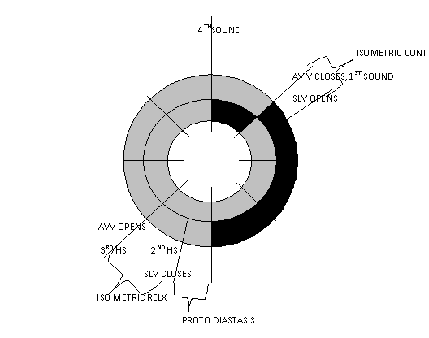
SYSTOLE
DIASTOLE

Slide 7
http://www.as.wvu.edu/~sraylman/physiology/cardiac_cycle_ct.swf

Slide 9
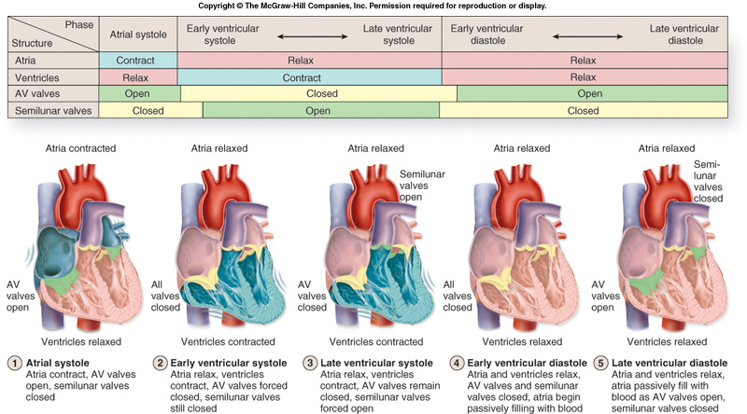

Slide 10
THANK YOU

