Slide 1
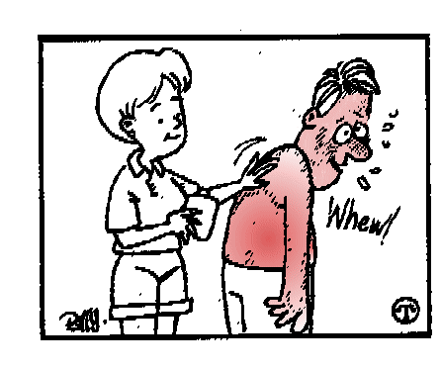
ECZEMA
Presented By
Mr. Jilo P Thomas
Nursing Tutor
College of Nursing Kishtwar

Slide 2
definition
Eczema is a form of dermatitis or inflammation of the epidermis (the outer layer of the skin)
The word 'eczema' comes from Greek words, that mean 'to boil over'.
Dermatitis’ comes from the Greek word for skin
both terms refer to exactly the same skin condition.

Slide 3
Anatomy of skin

Slide 4
Etiological factors

Slide 5
Clinical features
dryness and recurring skin rashes
redness, skin edema (swelling),
itching and dryness,
crusting, flaking,
blistering, cracking
oozing, or bleeding

Slide 6
types
Primary irritant dermatitis
results from prolonged or harsh chemical insult

Slide 7
etiology
Due to irritation to;
soaps and detergents,
shampoos (especially in hairdressing),
foodstuffs, and cutting oils.

Slide 8
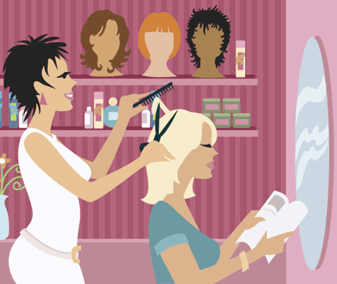
occupations
hairdressers; cooks and caterers;
machine-tool operators;
washers-up; nurses; and housewives/homemakers.

Slide 9
How to manage?
cessation of the provoking activity but,
use of topical corticosteroids to suppress inflammation
liberal use of emollients and non-soap cleansers
avoidance measures such as gloves and barrier creams.

Slide 10
Contact allergic dermatitis
Due to prolonged contact with allergen
Eg; nickel, ornaments
cement
Rubber materials
Phenyl diamines (hair dyes)
It is curable by avoiding the contact

Slide 11
Area involved commonly
Ear lobe
wrist

Slide 12
back (from metal clasp
on a brassiere).
Peri orbital ; due to cosmetics

Slide 13
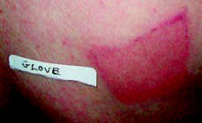
Investigation- patch test
suspected offending agents
are applied to the surface of
the skin for 48 hours before
being removed;
the site is then examined for
evidence of allergic
dermatitis
A second examination after 72 or 96 hours is also essential.

Slide 14
Results after 98 hours: several
positives in the standard and shoe
batteries.
Finn chamber patch testing to the back

Slide 15
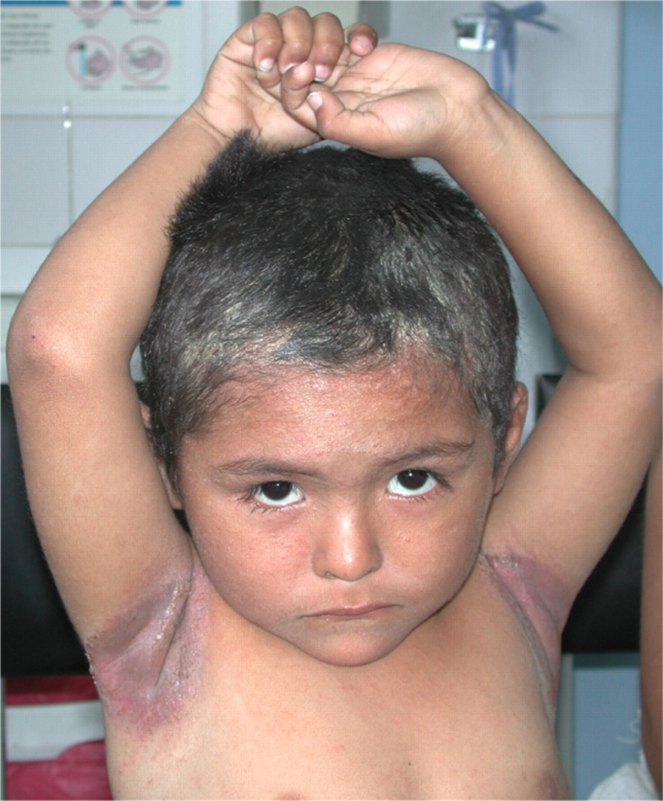
Infective eczema
by invading organisms.
The red, itchy rash that
Can be due to ring worm or fungus
Bacterial infections may occasionally produce similar changes.

Slide 16
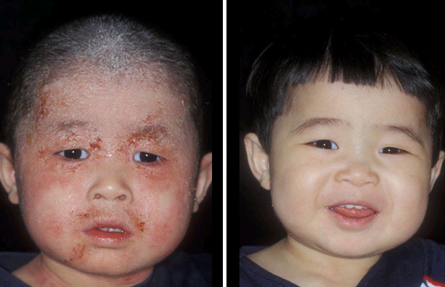
Atopic dermatitis
is an allergic disease believed to have a hereditary component
associated with asthma
Itchy rash is particularly noticeable on head and scalp, neck, inside of elbows, behind knees, and buttocks

Slide 17
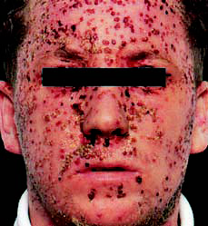
Atopic dermatitis is very common and associated with other atopic diseases such as asthma and hay fever.
• Atopic disorders are complex interactions between genetic susceptibility and the environmental factors.
• Begins often in the first year with red inflamed skin, dryness and intense itch.
herpes simplex

Slide 18
• Secondary staphylococcal infection is common;
superinfection with the herpes simplex virus can be life threatening.
Treatment is symptomatic and may involve emollients, corticosteroids, antihistamines, anti-infectives

Slide 19
Diagnosis criteria
• An itchy skin condition (or report of scratching/rubbing in a child)
plus three or more of the following:
• A history of involvement of the skin creases (folds of elbows; fronts of ankles; around neck; cheeks in children <4 years old).
• Personal history of asthma or hay fever (or of atopic disease in first degree relative

Slide 20
in children <4 years old).
• History of generalized dry skin in past year.
• Visible flexural eczema (or eczema of cheeks/forehead and outer limbs in children
<4 years old).
• Onset in first 2 years of life (not applicable to children <4 years old).

Slide 21
treatment
Emollients
Corticosteroids
Antihistamines
Anti-infectives
Tar; soothe itchy skin for many years;
Notes:
Antihistamines

Slide 22
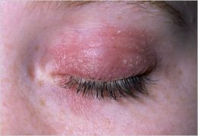
Xerotic eczema
is dry skin that becomes so serious it turns into eczema.
It worsens in dry winter weather, and limbs and trunk are most often affected.
The itchy, tender skin resembles a dry, cracked, river bed.
This disorder is very common among the older population

Slide 23
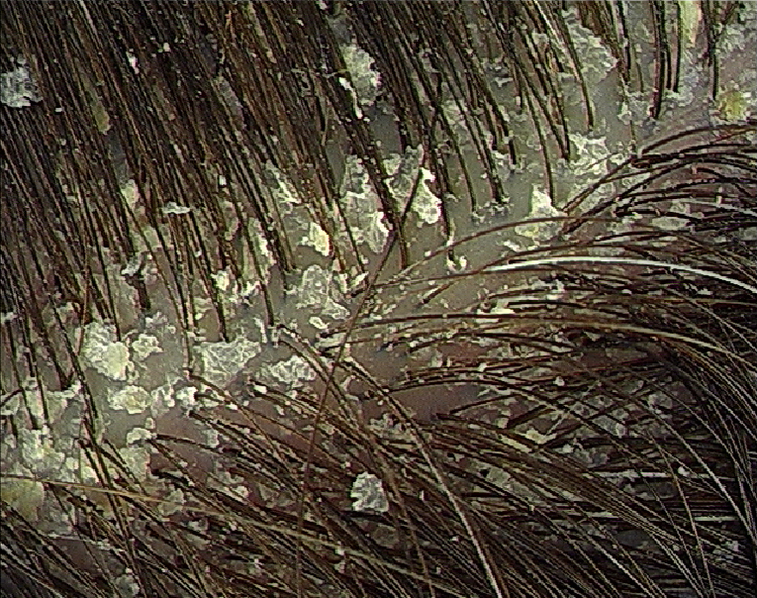
Seborrheic dermatitis
dandruff
a condition sometimes classified as a form of eczema that is closely related to dandruff.
It causes dry or greasy peeling of the scalp, eyebrows, and face, and sometimes trunk. The condition is harmless

Slide 24
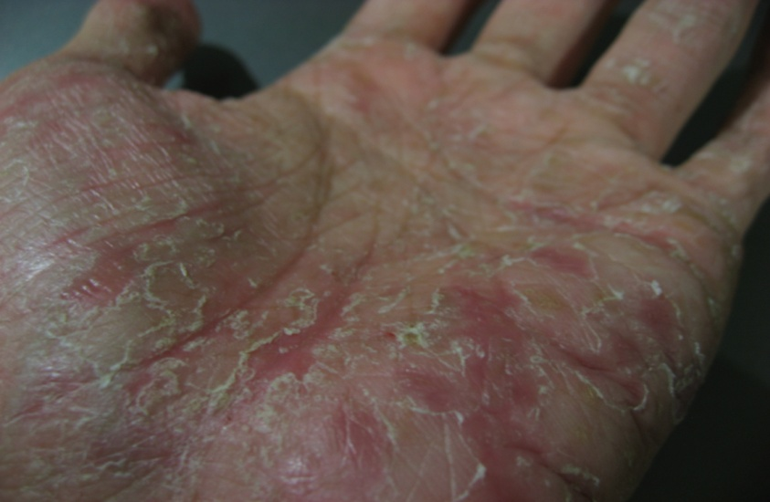
Dyshidrosis
occurs on palms, soles, and sides of fingers and toes.
Tiny opaque bumps called
vesicles
thickening, and cracks are accompanied by itching, which gets worse at night.
A common type of hand eczema, it worsens in warm weather.

Slide 25
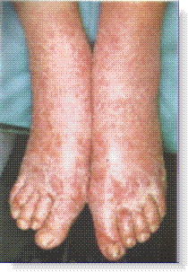
Discoid eczema
is characterized by round spots of oozing or dry rash, with clear boundaries, often on lower legs.
It is usually worse in winter. Cause is unknown, and the condition tends to come and go.

Slide 26
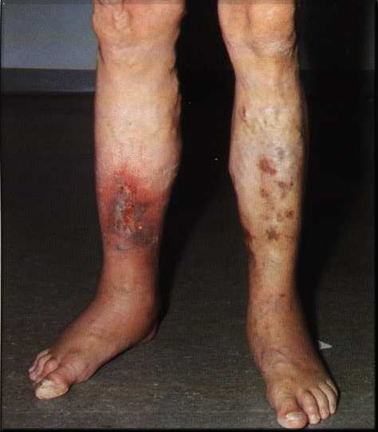
Venous eczema
occurs in people with impaired circulation, varicose veins and edema, and is particularly common in the ankle area of people over 50.
There is redness, scaling, darkening of the skin and itching.
The disorder predisposes to leg ulcers

Slide 27
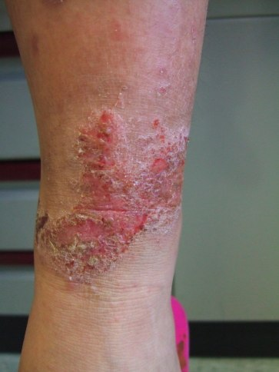
Neurodermatitis
is an itchy area of thickened, pigmented eczema patch that results from
habitual rubbing and scratching.
Usually there is only one spot.
Often curable through
behavior modification
and anti-inflammatory
medication

Slide 28
Nursing management??

Slide 29
Any query????????

