Slide 1
Presented by mrs. Bincy cherian asst. Professor college of nursing kishtwar
Endocrine Emergencies

Slide 2
Introduction: Endocrine System
Endocrine System controls Many body Functions, by Releasing Hormones
Hormones
Chemicals that Affect Endocrine Glands or Body Systems as well as ability to think with any clarity at all.
Endocrine
Release hormones directly into the blood which transport hormones to target tissue
Exocrine
Transport hormones to target tissue via ducts

Slide 3
Endocrine Emergencies: Diabetes Mellitus
Diabetes Mellitus
Carbohydrate utilization is reduced while that of lipid and protein is enhanced. Caused by insulin deficiency.
Type I: Insulin Dependent Diabetes Mellitus (IDDM)
Results from destruction of the insulin producing β cells of the pancreas. Evidence also suggests an increase in glucagon production by the α cells
Peak onset in ages 11 and 13 (often referred to as Juvenile onset diabetes). New onset over 30 very rare
Etiology differs; may be viral, environmental, and/or genetic. New cases usually occur in the fall and spring
Symptom onset abrupt
Prone to Ketoacidosis

Slide 4
Endocrine Emergencies: Diabetes Mellitus
Type I: IDDM
Clinical Presentation
Polydipsia - ↑ BGL = intracellular dehydration and hypothalamus thirst response
Polyuria - ↑ BGL = Glycosuria and osmotic diuresis
Polyphagia - ↓ cellular carbohydrate, fat, and protein = cellular starvation
Weight loss – Due to loss of body fluid and tissue
Fatigue – Poor use of food products

Slide 5
Endocrine Emergencies: Diabetes Mellitus
Type II: Non-Insulin Dependent Diabetes Mellitus (NIDDM)
May have normal insulin levels and/or β cells. Characterized by poor utilization of insulin
Generally occurs over 40 years of age. Accounts for most cases. If you’re of Pima Indian descent, sucks to be you
Patient is usually obese, suffering end-organ complications
3 times more prevalent in adults w/ lower socioeconomic/education status
Increased incidence in women with higher parity
End-Organ Complications of Diabetes
Accelerated atherosclerosis with medial calcification
Microvascular disease; abnormal functio of capillary basement membrane
Diabetic neuropathy; Autonomic dysfunction; Demyelination
Abnormalities of Schwann’s cells

Slide 6
Endocrine Emergencies: Diabetes Mellitus
Prehospital Management of Diabetic Emergencies
ABC’s/O₂
Ascertain history from patient and/or family/bystanders
Determine BGL (Normal range 60-120 mg/Dl)
Oral Glucose if BGL <60 and patient conscious.
If unable to take orally, est. IV and administer 25 g D50/W  Child 0.5 g/kg
If unable to est. IV or orals, Glucagon 1 mg SC/IM
Repeat glucoscan after glucose administration
Transport all patients on oral anti-hypoglycemic agents who develop hypoglycemia
In general, give IV D50/W for any hypoglycemia <50 even if oral glucose given

Slide 7
Endocrine Emergencies: Hypoglycemia
Hypoglycemia Defined
Fall in blood glucose concentrations that elicits symptoms of glucose deprivation in the central nervous system.
Sudden (Adrenergic sx)
Diaphoresis, pallor
Tremulousness
Tachycardia, palpitations
Visual distubances
Mental confusion, weakness,
Gradual
Fatigue
Confusion
Headach
Memory loss
Seizures, coma

Slide 8
Endocrine Emergencies: Hypoglycemia
Glucose Homeostasis
Glucoregulatory organs include liver, pancreas, adrenals, pituitary and the hormones they produce
Insulin (fed state)
Promotes uptake of glucose by the liver
Prevents use of other forms of energy (glycogenolysis, gluconeogenesis)
Fasting
Hepatic glycogenolysis (good for 24-48 hrs)
Prolonged fasting results in alternative energy source (lipoolysis, proteolysis)
Gluconeogenesis is source of glucose for brain metabolism
Hypoglycemia can result from disease of the glucoregulatory organs or from a breakdown of normal glucose homeostasis

Slide 9
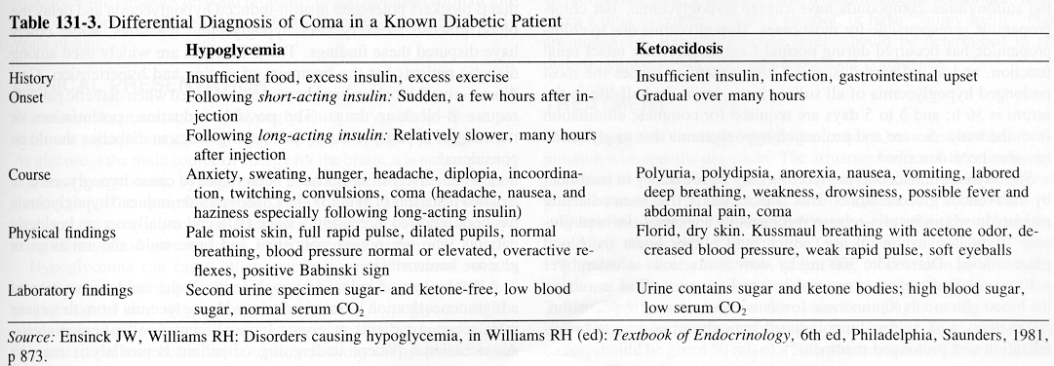
Endocrine Emergencies: Hypoglycemia
Pathophysiology
Spontaneous Hypoglycemia
Alimentary (gut defect, GI surgery, etc.)
Early diabetes (new onset Type II)
Idiopathic hypoglycemia
Fasting
-Islet-cell tumor
-Extrapancreatic neoplasms
-Endocrine related
-Hepatic disease
Induced Hypoglycemia
-Insulin induced
-Factitious
-Sulfonylureas (oral hypoglycemic agents)
-Alcohol
-Misc. drugs (ASA, etc.)

Slide 10
Endocrine Emergencies: Ketoacidosis
Diabetic Ketoacidosis Defined
Characterized by hyperglycemia and ketonemia. Occurs as a result of insulin deficiency and stress hormone excess resulting in hyperglycemic, acidotic, dehydrated patient with profound electrolyte disturbances.

Slide 11
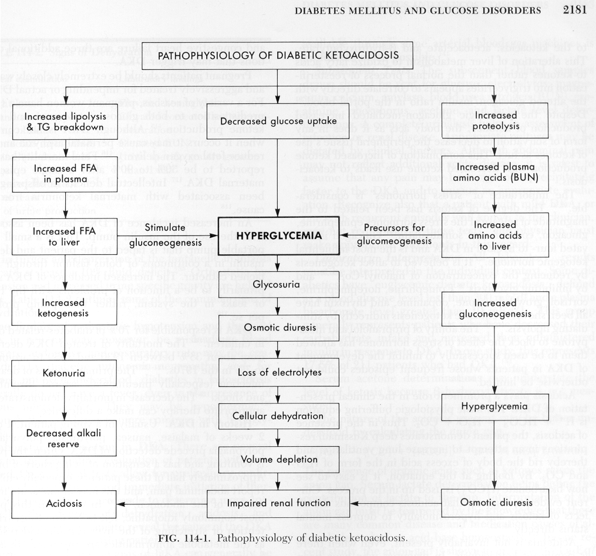

Slide 12
Endocrine Emergencies: Ketoacidosis
Clinical Manifestations
Polyuria, dehydration
Sodium, Phosphorous, Magnesium deficits
May have profound hypokalemia
Signs and symptoms
- Kussmaul respirations
- Postural dizzyness
- CNS depression
- Ketonuria
- Anorexia
- Nausea
- Abdonminal pain
- Thirst, polyuria
Treatment
- ABC’s, intubation for the comatose patient
Fluid resuscitation (BSS)

Slide 13
Endocrine Emergencies
Nonketotoc Hyperosmolar Coma
Severe hyperglycemia, hyperosmolality, and dehydration without ketoacidosis. Prehospital management is the same as for DKA.
Gestational Diabetes
Glucose intolerance that first occurs during preganancy. Usually occurs during the third trimester, obese women at greatest risk.

Slide 14
Endocrine Emergencies: Hyperthyroidism
DEFINITIONS
Thyrotoxicosis (Hyperthyroidism) Thyroid hormones exert greater than normal response
Thyroid Storm Rare complication of hyperthyroidism where manifestations of thyrotoxicosis become life threatening. Also may be termed Thyrotoxic Crisis.
Apathetic Thyrotoxicosis Rare form usually occurring in the elderly. Condition is often misdiagnosed as sx are few and subtle. Often presents as single organ failure (CHF). Patient may develop thyroid storm without the typical manifestations.
Graves Disease Most common cause of thyrotoxicosis, autoimmune disorder characterized by hyperthyroidism, enlarged thryoid (goiter), opthalmopathy and dermopathy

Slide 15
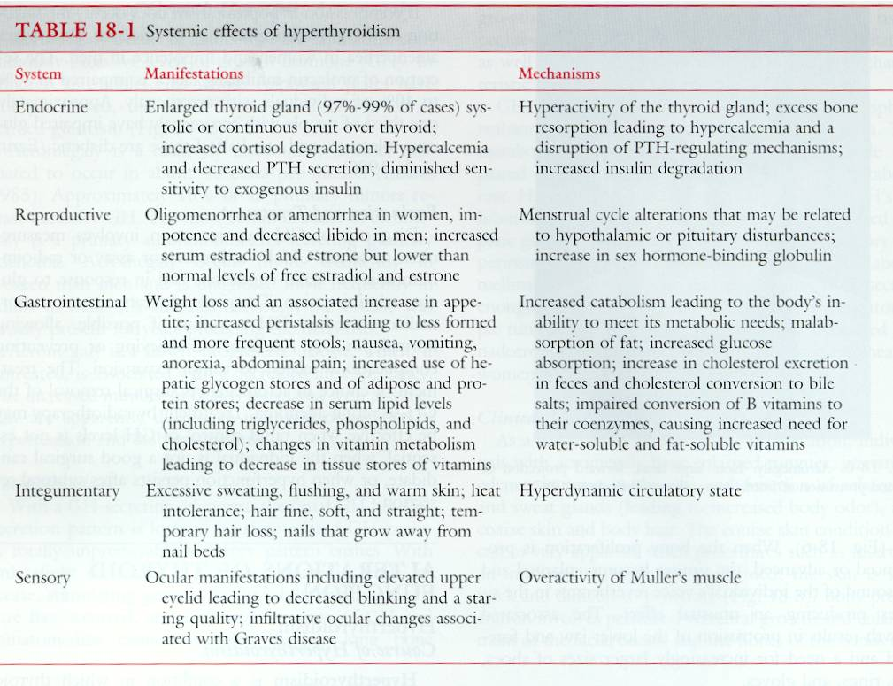
Tintinalli; Emergency Medicine; a comprehensive study guide

Slide 16
Endocrine Emergencies: Hyperthyroidism
Thyroid Storm
Precipitating Factors
Pulmonary infection
Diabetics; Ketoacidosis, hyperosmolar coma, insulin-induced hypoglycemia
Withdrawal of antithyroid drugs
Thyroid hormone overdose
Manipulation of the thyroid gland
Radioactive iodide
Vascular accidents (PE, etc.)
Toxemia of pregnancy
Trauma
Emotional Stress
Clinical Presentation
Diagnosis is difficult! General clues include:
Hx of Thyrotoxicosis
Graves disease (or it’s telltale eye signs)
Palpable goiter
Widened pulse pressure
Signs and Symptoms:
Fever, Tachycardia, Diaphoresis, Increased CNS activity and emotional lability.
If untreated will progress to a hyperkinetic toxic state, CHF, refractory pulmonary edema, shock, coma, and death

Slide 17
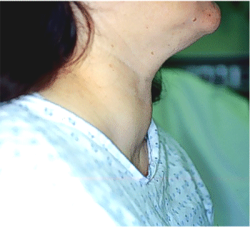
Goiter

Slide 18
Endocrine Emergencies: Hyperthyroidism
Thyroid Storm
Clinical Presentation (cont.)
CNS disturbances may include:
Anxiety, restlessness, agitation, psychosis, confusion, obtundation, coma.
Thyrotoxic myopathy
Cardiovascular abnormalities include
tachycardia, a fib
CHF
GI symptoms
Pre-event severe weight loss
Hyperdefecation, diarrhea
Anorexia, N/V

Slide 19
Endocrine Emergencies: Hyperthyroidism
Thyroid Storm
Treatment
Generally supportive
ABC’s, intubation for comatose patient
IV fluids
Antipyretics prn
Treat congestive failure/pulmonary edema per protocol
In-hospital therapies
IV glucocorticoids
Antithyroid preparations (PTU, Methimazole)
Retardation of TH release (iodide)
β blockade

Slide 20
Endocrine Emergencies: Hypothyroidism
DEFINITIONS
Hypothyroidism Chronic systemic disorder characterized by progressive slowing of all bodily functions because of thyroid hormone deficiency.
Primary Intrinsic failure of the thyroid gland
Secondary Disease of the hypothalamus and/or pituitary gland
Myxedema Refers to severe hypothyroidism. Nonpitting, dry, waxy swelling of the skin and SC tissue
Myxedema Coma Rare complication of hypothyroidism. Usually occurs in elderly women, during the winter as a result of stress.

Slide 21
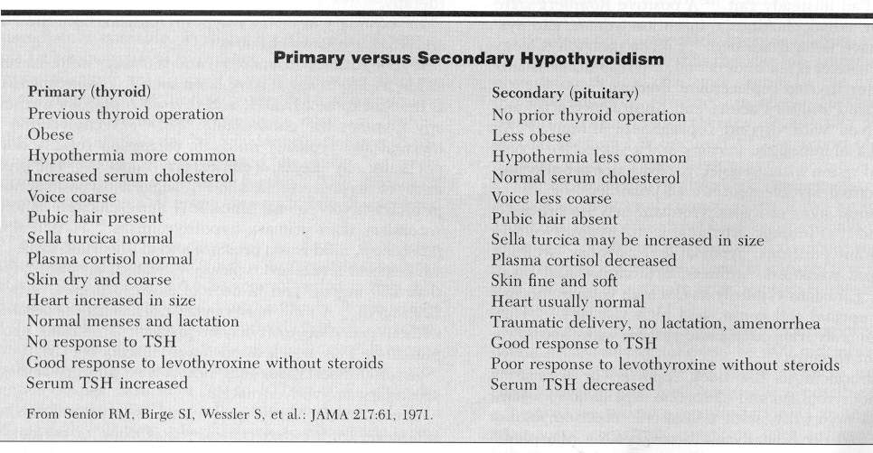
Endocrine Emergencies: Hypothyroidism

Slide 22
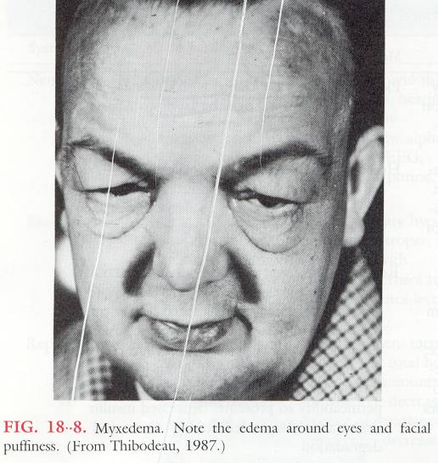
Endocrine Emergencies: Hypothyroidism

Slide 23
Endocrine Emergencies: Hypothyroidism
Myxedema Coma
Precipitating Factors
Pulmonary infection
Hypoglycemia
Exposure to cold environment
Hemorrhage
Hypoxia
CVA
Hypercapnia, Hyponatremia
Trauma
Failure to take thyroid replacement meds
Amiodarone, β blocker, phenothiazine administration
Clinical Presentation
Diagnosis not difficult w/ history of previous physical presentation:
Hx of thyroidectomy
Thyroid hormone replacement therapy
Iodine therapy
Diagnosis is difficult w/o the above information!

Slide 24
Endocrine Emergencies: Hypothyroidism
Clinical Presentation (cont.)
Hypothermia
Respiratory failure
Hyponatremia
Hypoglycemia
Cardiovascular changes
Hypotension
Cardomegaly
Bradycardia
Nervous system
-Coma
-Seizures
Treatment
ABC’s, intubation prn
Initial hyperventilation
Gradual Rewarming
Correction of hypoglycemia
Hypotension generally treated with pressors

Slide 25
Endocrine Emergencies: Adrenal Insufficiency
DEFINITIONS
Adrenal Insufficiency Decreased levels or absent hormones produced by the adrenal glands. May be a chronic disorder or acute life-threatening emergency.
Primary (Addisons Disease) Intrinsic failure of the adrenal gland resulting in inablility to produce cortisol and/or aldosterone
Secondary Disease of the hypothalamus and/or pituitary gland. Also can be due to prolonged steroid use
Acute Adrenal Insufficiency Acute emergency

Slide 26
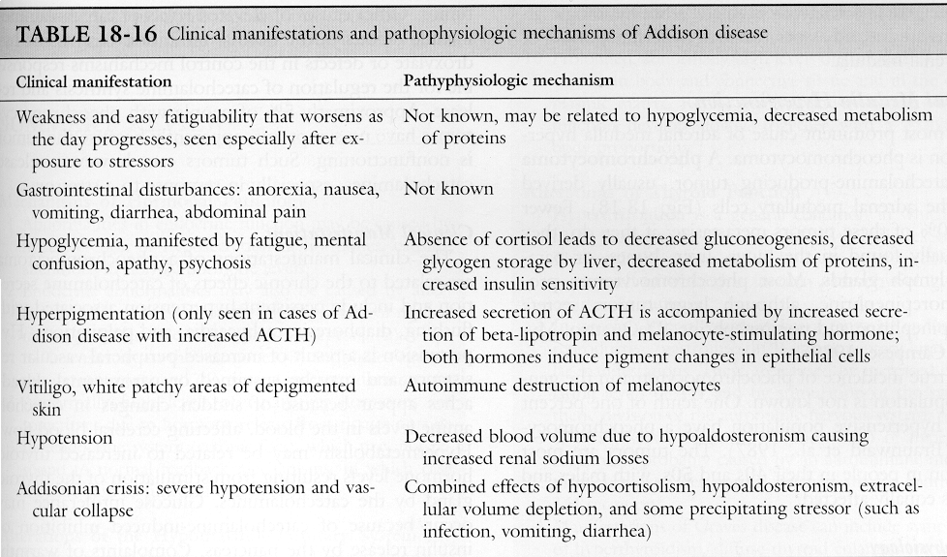
Endocrine Emergencies: Adrenal Insufficiency
Tintinalli; Emergency Medicine; a comprehensive study guide

Slide 27
Endocrine Emergencies: Adrenal Insufficiency
Acute Adrenal Insufficiency
Precipitating Factors
Chronic adrenal insufficiency and:
-New illness/stress
Hypermetabolic states
Pregnancy
Abrupt steroid withdrawal
Trauma, burns, surgery
Adrenal hemorrhage due to septicemia, etc.
Clinical Presentation
Due primarily to cortisol insufficiency
-Profoundly weak and confused
-Hypotension (significantly ↓ CO)
-Hyperpyrexia
-Anorexia, N/V, Abdominal pain
-Delirium, seizures
-Severe hypoglycemia
-May be hyperkalemic

Slide 28
Endocrine Emergencies: Adrenal Insufficiency
Treatment
ABC’s, intubation prn
Fluid resuscitation
Administration of glucocorticoid
Correction of hypoglycemia

