Slide 1
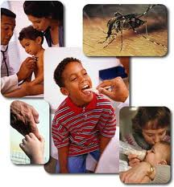
EPIDEMIOLOGICAL METHODS
Presented by:
Mr. Ajith K K
Asst. Professor
College of Nursing Kishtwar

Slide 2
EPIDEMIOLOGY
It is the study of frequency ,distribution and determinants of health related states in human population.

Slide 3
AIMS
To describe the distribution and magnitude of health and disease in human population.
To identify the risk factors in the pathogenesis of disease.
To provide data essential for planning,implimentation and evaluation.

Slide 4
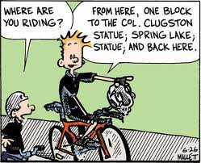

Methods of epidemiology
Observational method
Experimental method

Slide 5
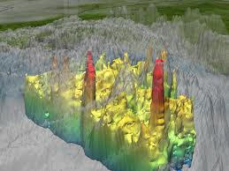

TYPES OF OBSERVATIONAL METHOD
DESCRIPTIVE STUDIES
ANALYTICAL STUDIES

Slide 6
USES OF DESCRIPTIVE STUDIES
It helps to know the extend of disease in the community.
To formulate an etiological hypothesis.
To know the distribution of disease with reference to time, place and person.
It helps in doing research.

Slide 7

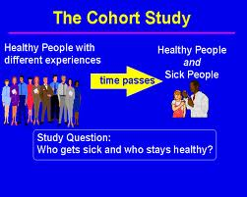
Types of analytical study
Case control study
Cohort study

Slide 8
Steps in case control study
Selection of cases.
Selection of controls.
Matching
Measurement of exposure among the both groups.
Analysis.

Slide 9
Frame work of case control study
SUSPECTED FACTORS | CASES | CONTROLS
PRESENT | a | b
ABSENT | c | d
TOTAL | a+c | b+d

Slide 10
Work sheet
ALCHOHOLISM | CASES | CONTROLS
PRESENT | 15OO | 3000
ABSENT | 2500 | 4000
TOTAL | 4000 | 7000

Slide 11
TYPES OF COHORT STUDIES

Slide 12
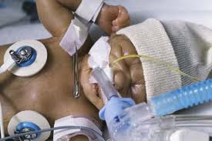
PROSPECTIVE STUDIES
It begins in present and continuous in future and terminates.

Slide 13
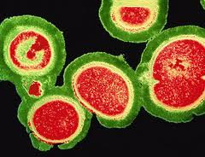
Retrospective study
In this study the investigator goes in time for about 15-20 years to select a study groups from the existing records.

Slide 14
Combination of retrospective and prospective study

Slide 15
Steps in cohort study.
Selection of cohort
Selection of control cohort
Follow up
Analysis

Slide 16
advantages of cohort study
It provide information about true incidence rate.
Helps to estimate relative and attributable risk.
Allows the assessment of dose responds relationship.
Helps to accept or refuse hypothesis with high degree of validity.

Slide 17
disadvantages of cohort study
Expensive time consuming and difficult.
Administrative problems
Lack of experienced staff
Lack of funds
Reduction of size in groups occur due to death or migration.
It involves ethics.

Slide 18
Types of experimental methods

Slide 19

Clinical trial/randomised control trial

Slide 20

Field trials/community interventional study

Slide 21
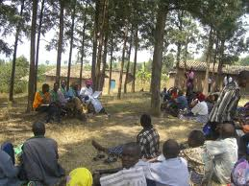
Community trials

Slide 22

THANK YOU

