Slide 1
FIRST REFERRAL UNIT

Slide 2
Introduction
Historical background
CSSM Programme- setting up FRUs at the community health centers/sub-district level hospitals.
RCH Programme
-Supply of Emergency Obstetric Drug Kit
-Provision for Private Anesthetic Services
Drug and Cosmetics Rule

Slide 3
Tenth Plan: Recommended Approach
Identified establishment of fully functional and operational FRUs as the priority area for the provision of Emergency Obstetric and New-born Care.
By the end of the Tenth Five Year Plan, each district should have at least 3-4 fully functional facilities which are equipped to provide Emergency Care on a round-the-clock basis.

Slide 4
Cont…..
Mapping the existing health facilities, available manpower and other resources for each district

Slide 5
Critical Determinants of a FRU’s
24-hour delivery services including normal and assisted deliveries
Emergency Obstetric Care including surgical interventions like Caesarean Sections and other medical interventions
New-born Care
Emergency Care of sick children
Full range of family planning services including Laproscopic Services

Slide 6
Cont….
Safe Abortion Services
Treatment of STI / RTI
Blood Storage Facility
Essential Laboratory Services
Referral (transport) Services

Slide 7
Points to be consider while selecting the facility
Infrastructure needs
A minimum bed strength of 20-30 and North- East and EAG States of 10-12 beds initially.
A fully functional operation theatre equipped for undertaking anesthetic and
emergency surgical procedures.
A fully operational Labour Room.

Slide 8
Cont………
An area earmarked and equipped for New-born Care in the Labour Room and also in the ward.
A functional laboratory with facilities for all essential investigations.
Blood storage facility as per the guidelines issued by Govt. of India (GoI).
24-hour water supply.
Arrangements for waste disposal.

Slide 9
Cont……
Regular electricity supply with back-up arrangements to ensure uninterrupted supply
Telephone connection.
Ambulance (owned or arranged through local hiring).

Slide 10
Cont….
Selection of sites
Under the RCH Programme funds were provided to CHCs and district hospitals.

Slide 11
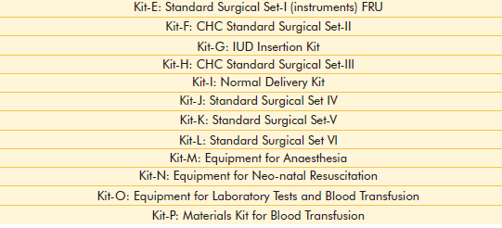
Equipment Kits Supplied Under CSSM Programme

Slide 12
Human resources: Re-deployment and multi-skilling
Policy options for human resource management
Facilities to manage Obstetrical and medical emergencies.
strength of 4 medical officers (surgeon, obstetrician, physician and pediatrician) was recommended.
Adequate number of Medical Personnels including nursing staffs.
In-patient wards.

Slide 13
Cont….
Re-deployment & multi-skilling
Strengthening of BPHCs and PHCs will be done in a need based manner.
All the block PHCs shall have minimum 30 indoor beds with complete facilities for institutional delivery and usual indoor treatment care.
Well-functioning PHCs running with indoor facilities will be identified and their infrastructure strengthened.

Slide 14
Cont….
The existing manpower will be strengthened by withdrawing and posting of manpower from PHCs that are providing only OPD services.
All the staff of PHCs, doing outdoor services shall be with drawn and re-deployed in BPHCs and PHCs running

Slide 15
Cont….
Provision of support services like blood storage, Laboratory services, pharmacy services.
Assessment of available manpower and other resources in FRUs.
Training programme (FOGSI)
Multi-skilling training of paramedical workers

Slide 16
Functional/financial autonomy
Hire locally available specialists and/or paramedical workers from the private/ NGO sector in case of need
Make local arrangements for referral transport
Generate resources locally and
Out-source non-clinical services.

Slide 17

Referral Transport
(i) Appropriate referral transport from the periphery to the functioning First Referral Units providing emergency services
and
(ii) Also from FRUs to district/tertiary level institutions.

Slide 18

Selection of FRU Unit

Slide 19

Current Information
1992-1997 - 105 FRUs in Tamil Nadu
2009 - 291 FRUs in Tamil Nadu

Slide 20
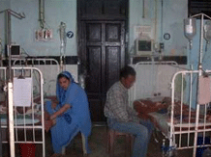
Summary

Slide 21
Evaluation
………, …………,$ ………….. are the clinical facilities should be needed in PHCs or CHCs to declare as a FRU.
Under CSSM Programme, ……… number of kits were designed for surgical procedure.
Up to 2009, the total number of FRUs operationalised in Tamil Nadu is ………

Slide 22
Assignment
  Write an assignment on standing orders followed in FRU in case of obstetrical emergencies.

Slide 23
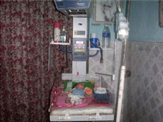
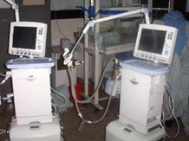
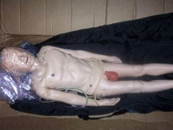
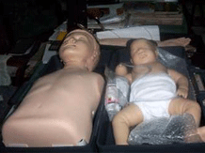
Conclusion

Slide 24

THANK YOU

