Slide 1

NAME: Mr. Jones.
AGE: 24 yrs.
SEX: Male
PRESENTING HISTORY: Severe vomiting and dehydration.
PHYSICAL EXAMINATION: Rough and dry tongue, dry and sticky mucus membrane, disoriented and restless.
LAB INVESTIGATIONS:
Serum sodium level= 152 mEq/L

Slide 2
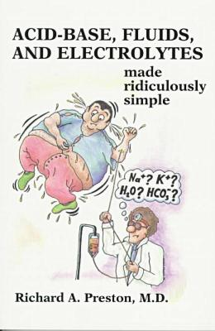
FLUID AND ELECTROLYTE IMBALANCES
PRESENTED BY:
Ms. Mariya Oliver
Asst. Professor
College of Nursing Kishtwar

Slide 3
Fluid Distribution
Infants : 70 – 80%
Adults : 50 – 60 %
Older adults : 45- 55%

Slide 4

FLUID LOSSES
Insensible losses
From skin.
From lungs.
Sensible losses
Urination.
Defecation.
Wounds.

Slide 5
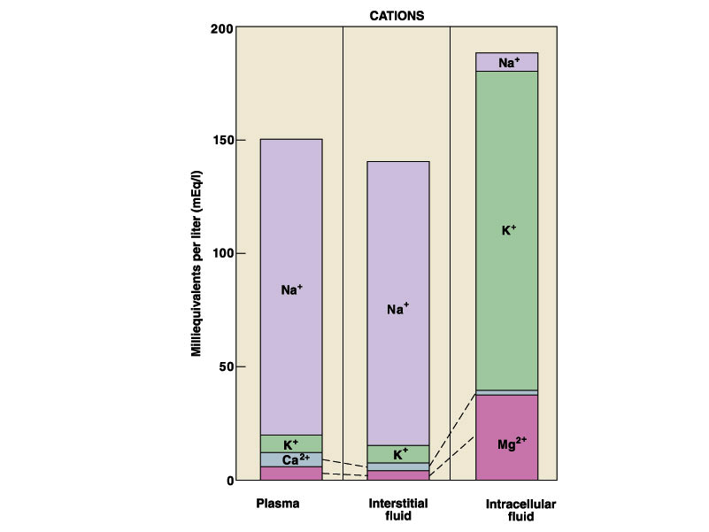
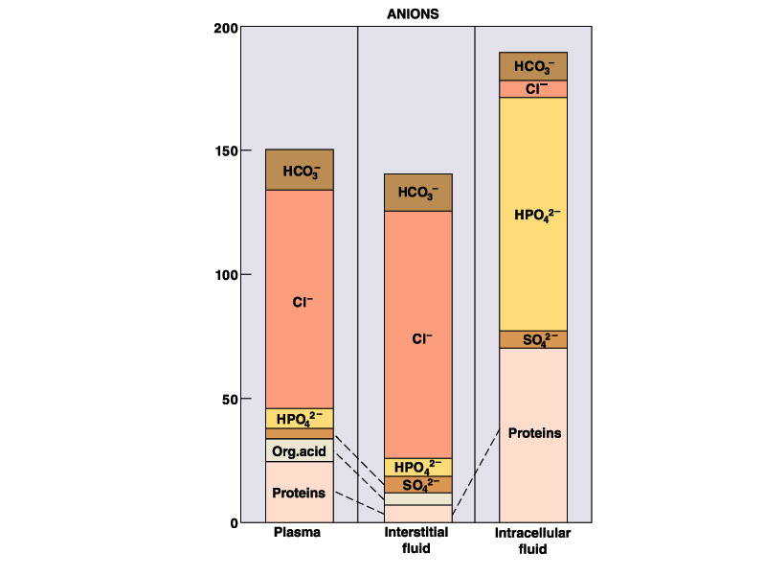
Understanding Electrolytes

Slide 6
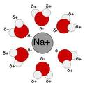
Sodium
Main ECF cation.
ECF osmolality.
Acid – base balance.
Nerve & muscle cell activation.
Influence water distribution.
Normal value = 135 – 145 mEq/L

Slide 7

Potassium
Main ICF cation.
Regulates cell exitability.
Permeability of cell.
ICF osmolality.
Normal value
= 3.5 – 5 mEq/L

Slide 8

Chloride
Main ECF anion.
ECF osmolality.
Body pH.
Acid – base balance (cl + H =Hcl.)
Normal value = 98 – 106 mEq/L.

Slide 9
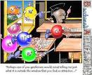
Magnesium
ICF cation.
Enzymatic and metabolic processes (protein synthesis.)
Impulse transmission.
Normal value =
1.5 – 2.5 mEq/L

Slide 10

Phosphorous
ICF anion.
Energy storage.
Carbohydrate, protein and fat metabollism.
Hydrogen buffer.
Normal value =
2.5 – 4.5 mg/dl.

Slide 11

CALCIUM
Cation in teeth & bones.
Fairly equal in ECF & ICF.
Enzyme activator.
Adherence of cells to each other.
Muscle contraction.
Blood coagulation.
Normal value = 9 – 11 mg/dL.

Slide 12
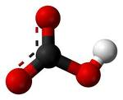
Bicarbonate
Present in ECF.
Regulate acid – base balance.
Normal value = 22 – 26 mEq/L.

Slide 13

Movements of Fluids and Electrolytes
Diffusion
The process by which solutes move from an area of higher concentration to one of lower concentration; Does not require expenditure of energy.

Slide 14
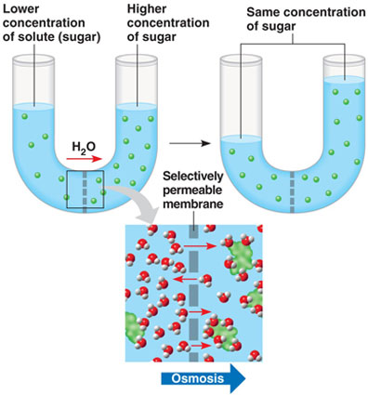
Osmosis
The process by which fluid moves across a semipermeable membrane from an area of low solute concentration to an area of high solute concentration.

Slide 15

Active Transport
Physiologic pump that moves fluid from an area of lower concentration to one of higher concentration; active transport requires adenosine triphosphate (ATP) for energy.

Slide 16

Filtration
Movement of water and solutes occurs from an area of high hydrostatic pressure to an area of low hydrostatic pressure.

Slide 17


FLUID VOLUME IMBALANCES

Slide 18

FLUID VOLUME DEFICIT
Fluid volume deficit (FVD) occurs when loss of extracellular fluid volume exceeds the intake of fluid.
Fluid and electrolytes are lost.
Dehydration = only fluid loss.

Slide 19

Etiology
water loss or perspiration.
Diabetes insipidus.
Osmotic diuresis.
Haemorrhage.
GI losses.
fluid intake.
Burns, intestinal obstruction.

Slide 20

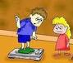
Clinical Manifestation
Restlessness.
Confusion.
Dizziness.
Thirst.
Dry mouth.
skin turgor.
urine output.
Weight loss.
Seizures.
Coma.
Postural hypotension.

Slide 21

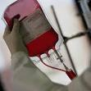
Medical management
Balanced IV solution.
Blood transfusion.

Slide 22
Nursing Diagnoses
Fluid volume deficit, related to excessive fluid loss or decreased fluid intake.
Decreased cardiac output related to excessive fluid loss or decreased fluid intake.
Risk for complications: hypovolemic shock.

Slide 23
FLUID VOLUME EXCESS
Fluid volume excess (FVE) refers to an isotonic expansion of the ECF caused by the abnormal retention of water and sodium in approximately the same proportions in which they normally exist in the ECF.

Slide 24

Etiology
Excessive isotonic IVF.
Heart failure.
Renal failure.
Syndrome of Inappropriate Antidiuretic Hormone secretion.
Long – term use of corticosteroids.

Slide 25



Clinical Features
Headache, confusion, lethargy.
Peripheral edema.
Distended neck veins.
Dyspnea. Crackles, pulmonary edema.
Increased BP, bounding pulse.
Polyuria.
Muscles spasm.
Weight gain.

Slide 26


Management
Diuretics.
Restriction of sodium intake.
Ascities – abdominal paracentesis.
Pleural effusion – thoracocentesis.

Slide 27
Nursing diagnosis
Excess fluid volume.
Impaired gas exchange.
Disturbed body image.
Risk for impaired skin integrity.
Risk for complications (pulmonary edema, ascities.)

Slide 28

HYPONATREMIA
TYPES
True.
Dilutional.
ETIOLOGY
Excessive sodium loss.
Inadequate sodium intake.
Excessive water gain.
Disease states.
HYPERNATREMIA
Excessive sodium intake.
IV fluids.
Near drowning in salt water.
Excessive water loss.
Disease states.

Slide 29
CLINICAL FEATURES
Confusion.
Nausea, vomiting.
Weight gain.
Edema, oliguria.
Muscle spasms.
Convulsions.
Sodium level under 136 mEq/L.
Thirst.
Rough, dry tongue.
Dry, sticky mucus membrane.
Restlessness, lethargy, disorientation, seizures
Muscle weakness and irritability.
Sodium level above 145 mEq/L.

Slide 30

Nursing Diagnoses

Slide 31
HYPOKALEMIA
HYPERKALEMIA
CAUSES
GI losses.
Renal losses.
Antibiotics – penicillin G.
Steroid therapy.
Severe perspiration.
Poor nutrition.
Alkalosis.
Decreased renal excretion.
High potassium intake.
Acidosis.
Tissue damage.

Slide 32
Signs and Symptoms
Fatigue, muscle weakness (respiratory).
Prolonged cardiac repolarisation.
Decreased cardiac contractility.
Flat ST segment and Q wave on ECG.
Orthostatic hypotension.
Potassium level below 3.5mEq/L
Cardiac conduction disturbances.
Ventricular arrhythmias.
Prolonged depolarisation.
Tall, tented T wave, prolonged QRS complex PR interval.
Nausea, vomiting.
Potassium level above 5 mEq/L.

Slide 33

Nursing Diagnosis

Slide 34
Calcium Imbalances
Hypocalcemia
< 9 mg/dL
Hypercalcemia
> 11 mg/dL

Slide 35
HYPOCALCEMIA
CAUSES
Hypoparathyroidism.
Acute pancreatitis.
Hyperphosphatemia.
Inadequate dietary intake of vitamin D.
Medullary throid carcinoma.
HYPERCALCEMIA
Malignant neoplasms.
Metastatic bone cancer.
Hyperparathyroidism.
Immobilization and bone demineralization.
High calcium intake.
Hyperthyroidism or hypothyroidism.

Slide 36
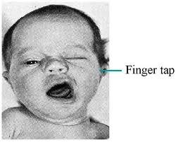

S/S of hypocalcemia
Fatigue.
Depression, anxeity, confusion.
Numbness and tingling around the mouth.
Positive Chvostek’s sign.
Positive Trousseau’s sign.
Hyper reflexia, muscle cramps.
Tetany, laryngeal spasm.

Slide 37
S/S of hypercalcemia
Lethargy, weakness.
Depressed reflexes.
Confusion, personality changes, psychosis.
Anorexia, nausea, vomiting
Polyuria.
Bone pain.
Stupor, coma.
Nephrolithiasis.

Slide 38
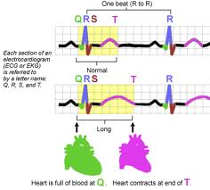
ECG changes
Elongated ST segment.
Prolonged QT interval.
Ventricular tachycardia.
Shortened ST segment.
Shortened QT interval.
Ventricular dysarrhythmias.

Slide 39

Nursing Diagnosis

Slide 40
Magnesium Imbalances
Hypomagnesemia
< 1.5 mEq/L
Hypermagnesemia
> 2.5 mEq/L

Slide 41
Hypomagnesemia
Hypermagnesemia
Causes
Alcoholism
Protien- calorie malnutrition
Iv therapy without magnesium replacement
Malabsorption syndrome
GI suctioning
Laxative abuse
Intestinal bypass for obesity
Burns
Renal failure
Excessive antacid use
Adrenal insufficiency
Diuretic abuse
Excessive magnesium replacement
Excessive use of milk of magnesia or other magnesium contacting laxatives

Slide 42
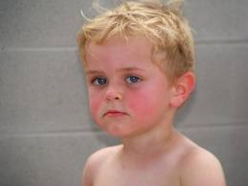
Signs and symptoms
Muscle weakness. tremors, tetany.
Clonic – focal seizures.
Laryngeal stridor.
Decreased BP.
Apathy, depression, agitation, confusion.
Nausea, vomiting, anorexia.
Positive Chvostek’s sign and Trousseau’s sign.
Peripheral vasodilation.
Facial flushing.
lethargy, or drowsiness.
Loss of deep tendon reflexes.
Paralysis
Cardiac arrest.

Slide 43
Nursing Diagnosis

Slide 44
PHOSPHATE IMBALANCES
HYPOPHOSPHATEMIA
< 2.5 mg/dL
HYPERPHOSPHATEMIA
> 4.5 mg/dL

Slide 45
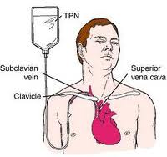
HYPOPHOSPHATEMIA
CAUSES
Overzealous feeding.
Malabsorption syndrome.
Nutritional recovery treatment.
Parentral nutrition.
Alcohol withdrawal.
Phosphate binding antacids.
Respiratory alkalosis.
HYPERPHOSPHATEMIA
Renal failure.
Chemotherapeutic agents.
Enemas containing phosphorous.
Excessive ingestion.
Hypothyroidism.

Slide 46
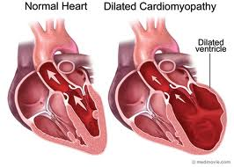
Signs and Symptoms
CNS dysfunction.
Muscle weakness (resp)
Dysrhythmias.
Osteomalacia.
Congestive cardiomyopathy.
Hemolytic anemia.
Hypocalcemia.
Muscle problems like tetany.
Soft tissue calcification.
Increased red blood cell count.

Slide 47
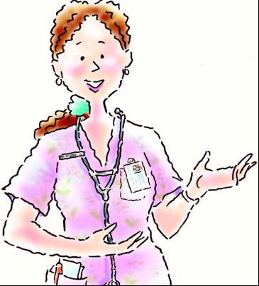
Nursing Care

Slide 48

THANK YOU

