Slide 1
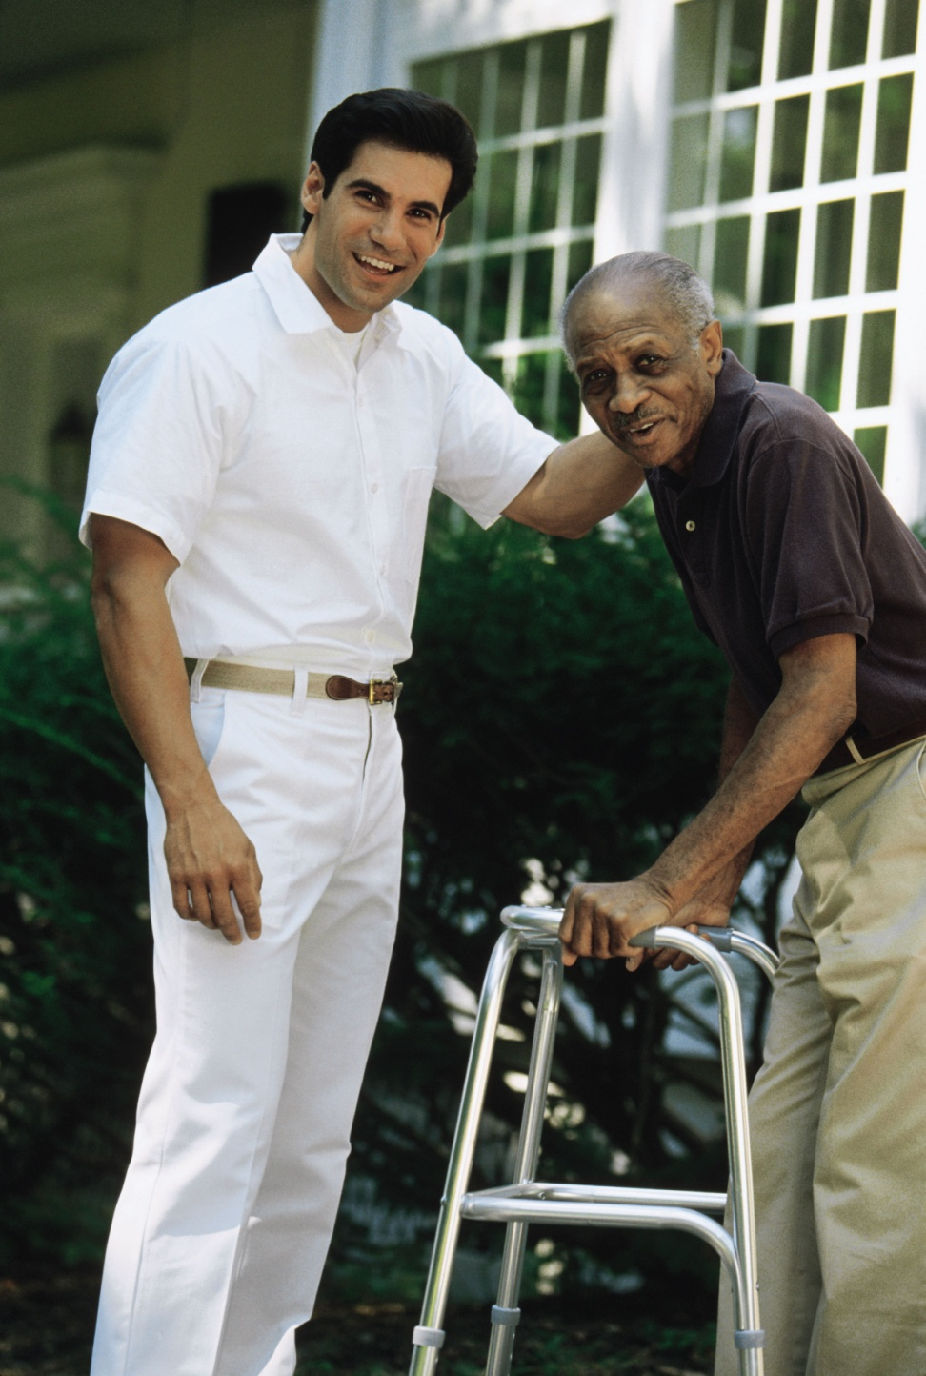


GERIATRIC ASSESSMENT
PRESENTED BY
MS. MARIYA OLIVER
Asst. Professor
College of Nursing Kishtwar

Slide 2

HISTORY COLLECTION
Establish a good rapport with the patient.
Establish the patient’s well – being as your primary concern.
Help the patient to promote his health awarness.

Slide 3

Under-Reporting Due To:
Belief that symptoms are due to old age
Fear or denial
Concern about cost
Embarrassment
Mental impairment
Concern about ill spouse
Previous bad experience with health care system
Fear of institutionalization

Slide 4

Hidden Illness:
You Must Ask, They Won’t Tell!
Sexual dysfunction
Depression
Incontinence
Musculoskeletal stiffness
Alcoholism
Hearing loss
Memory loss

Slide 5

Physical Examination
Begin from head to toe examination
Observe the overall apperance, including the body built, skin, hygiene, and grooming.
Assess the general mobility status.
Observe the level of consciousness, affect and mood.
Observe for overt signs of distress.
Take the vital signs (including .orthostatic blood pressure.)

Slide 6

Skin
Normal changes
Subcutaneous fat loss, dermal thinning, and decreasing collagen lead to the development of facial lines (crow’s feet) around the eyes, mouth and nose.
Women’ skin is thinner, so shows signs of aging about 10 earlier.

Slide 7

Mucus membrane becomes dry.
Sweat glands decrease in size and number.
Skin losses its elasticity.
Senile lentigo.
Greying of hair occurs.
Body temperature regulation becomes harder due to loss of sweat glands and subcutaneous fat.

Slide 8


Senile keratosis.
Acrochordon.
Senile angiomas .
Facial hair increases in postmenopausal women and decreases in men.
Longitudinal ridges, thickening, brittleness, and malformations are seen in the nails.

Slide 9
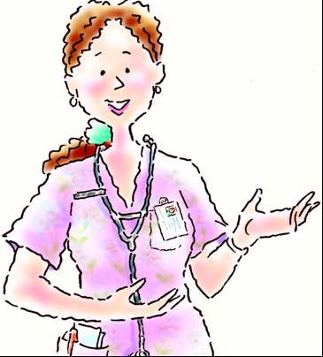
Assessment aspects
Inspect the skin on the patient’s scalp, head, neck, trunk and limbs.
Note the colour, temperature, texture, tone, turgor, thickness, and moisture.
Inspect for any tears, lacerations, scars, lesions, and ulceration.
Note for any common benign skin lesions.

Slide 10
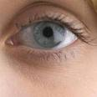

Eyes and Vision
Normal changes
The eyelids lose their elasticity becoming baggy and wrinkled.
The conjunctiva becomes thinner and yellow, and pingueculae (yellowish spots) may develop on the bulbar conjunctiva.
The lacrimal apparatus gradually loses fatty tissue leading to diminish in tear quantity

Slide 11
The pupil shrinks, decreasing the amount of light that reaches the retina.
The vitreous humor may degenerate over time, revealing opacities and floating vitreous debris on examination.
The vitreous may detach from the retina, appearing as an empty space. Through an ophthalmoscope, the detached vitreous looks like a dark ring in front of the optic disk.
The lens enlarges and loses its transparency with age.
Impaired color vision especially blue and green.

Slide 12
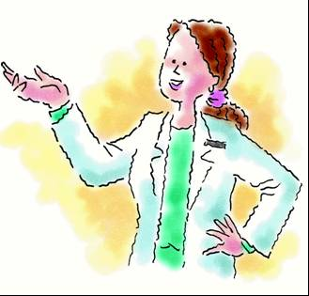
Assessment aspects
Check for any lesions or edema.
Note the direction of the eyelashes.
Inspect the lacrimal apparatus.
Examine the sclera and conjunctiva.
Inspect the pupils.
Observe the iris.
Test the patient’s visual acuity with and without corrective lenses.
Perform an ophthalmic examination.

Slide 13
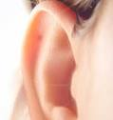
Ears & Hearing
Senile deafness (presbycusis)
The sensory hearing loss, where the auditory nerve and organ of corti are affected, is more common.

Slide 14
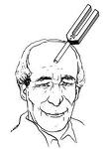
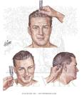
Assessment aspects
Auricle ; the colour and temperature changes, discharges, or lesions, tenderness.
Inspect the internal ear structure with an otoscope.
External canal and tympanic membrane; any lesions, bulging of the tympanic membrane, cerumen buildup or hair growth (in males.)
Perform the Weber’s and Rinne’s test to detect any hearing loss.

Slide 15

Gastrointestinal System
Normal changes
caloric need decreases (about 400 calories for women and 500 calories for men.)
Diminished enzyme activity.
Loss of calcium and nitrogen.
Decreased salivary flow and a reduced taste sensation

Slide 16
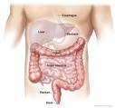
Reduced intestinal motility and intestinal peristalsis.
The signs and symptoms range from appetite loss to esophageal reflux to constipation.
Thinning of the tooth enamel, causing teeth to become more brittle.

Slide 17
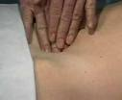
Assessment aspects
Inspection; the abdomen, noting its shape, symmetry, and any scars, masses, pulsations, distensions, or striae.
Describe the abdomen as obese, scaphoid, or distended.
Auscultate all four abdominal quadrants for bowel sounds
Listen over the abdominal aorta for bruits.
Percuss the abdomen to determine the presence of air or fluid, assess liver size, and check for bladder distension.
Palpate the belly, noting masses, or tenderness on light or deep palpation.

Slide 18
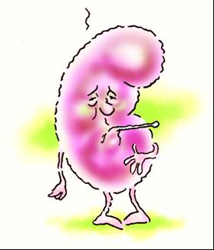
Urologic System
Normal Changes
Age related changes in renal vasculature will disturb the glomerular hemodynamics and reduce the glomerular filtration rate.
The renal blood flow decreases.
Tubular reabsorption and renal concentrating ability also declined as the size and number of functioning nephrons decrease.

Slide 19
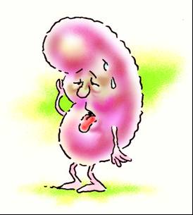
The bladder muscles weaken causing incomplete bladder emptying and chronic urine retention – leading to bladder infection.
Residual urine, urinary frequency, and nocturia are more common.
Diminished kidney size.
Impaired renal clearance of drugs.
Reduced bladder size and capacity.
Decreased renal ability to respond to variations in sodium intake.

Slide 20

Female Reproductive System
Normal Changes
Breast becomes pendulous.
Nipples becomes smaller and flatter and nonerrect.
Menopause.
Loss of pelvic structure elasticity due to lack of estrogen.
Urinary stress incontinence.

Slide 21
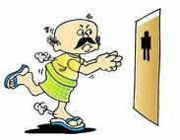
Male Reproductive System
Decrease in testosterone production.
Decrease in libido.
Atrophy and shortening of the testes, which leads to decrease in sperm count.
Greater risk of UTI.

Slide 22
Musculoskeletal System
Normal Changes
Decrease in height due to spinal curvature, narrowing of intervertebral spaces.
Decrease in bone mass.
Greater viscosity of synovial fluid.
Decreased collagen hences stiffness of joints.
Osteoporosis.
Osteoarthritis.

Slide 23
Assessment points
Gait and posture. Gait reflects integration of reflexes as well as motor function.
Observe the patient’s tandem (heel-to-toe) walking, watching for exaggerated ataxia.
Posture and balance; elicit the Romberg’s sign by noting if the patient sways or falls when standing with his feet close together and eyes closed.
Joints ;any enlargements, swelling, tenderness, crepitus, temperature changes or deformities
Assess the ability to perform activities of daily living.

Slide 24
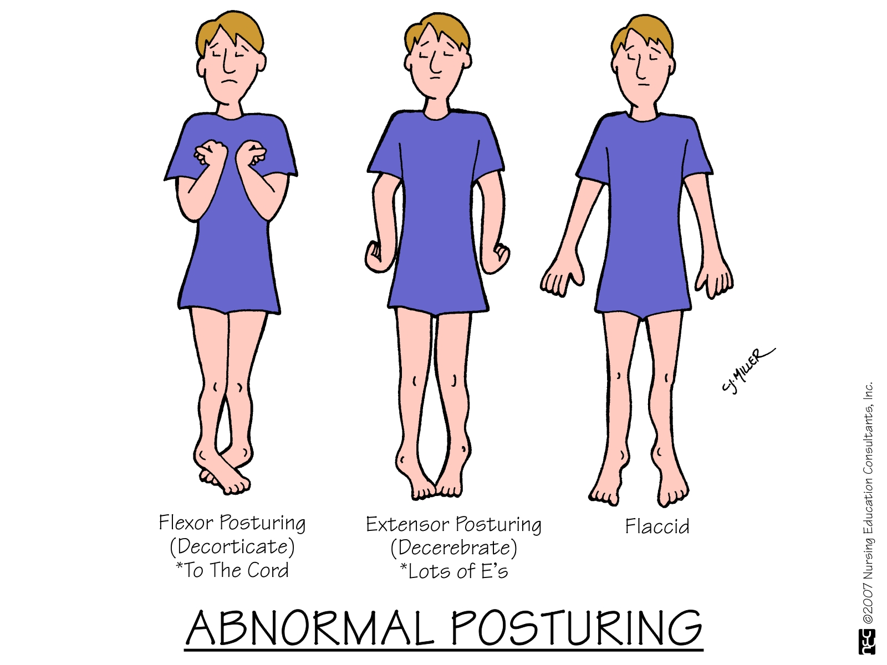

Slide 25

Nervous system
The neurons degenerate and the nerve transmission slow, causing the elderly adult to react more sluggishly to external stimuli.
The hypothalamus becomes less effective at regulating the body temperature. The pain threshold increases.
Certain sleep stages shorten.

Slide 26

Mental Status Examination
General appearance and behaviour.
State of consciousness.
Mood and affect.
Thought content.
Intellectual capacity.

Slide 27
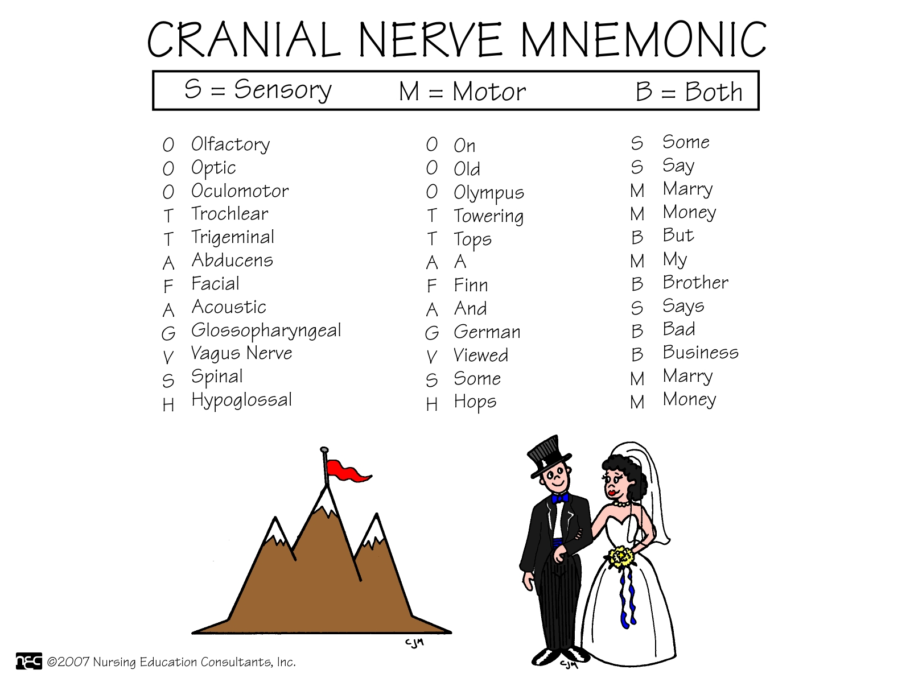
Cranial Nerve Assessment

Slide 28
Motor System
Muscle size.
Muscle strength.
Muscle tone.
Muscle co-ordination.
Gait and station.
Movements.
Motor testing of the unconscious patient.

Slide 29
Sensory Functioning
Superficial sensation.
Mechanical sensation.
Discrimination – stereognosis, graphesthesia, extinction phenomenon.

Slide 30
Reflex Activity
1. Superficial reflex.
Abdominal reflex.
Plantar reflex.
Corneal reflex.
Pharyngeal (gag) reflex.
Cremasteric reflex.

Slide 31
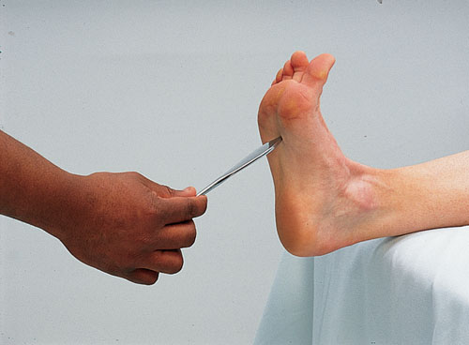

Slide 32
Deep Tendon Reflex
Biceps reflex
Triceps reflex
Brachioradialis reflex
Platellar reflex
Achilles reflex (“ankle jerk”)

Slide 33
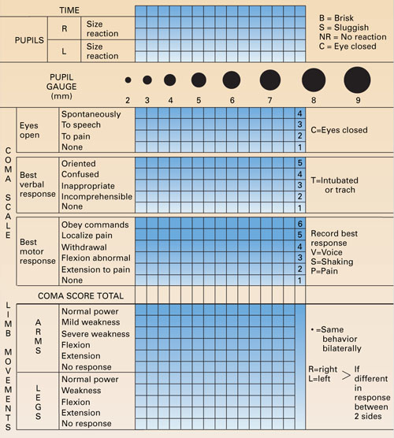

Slide 34

Endocrine system
Altered glucose metabolism occurs and hence there is a decreased ability to tolerate stress.
The thyroid hormones decrease by 25% in older adults BMR decreases.
In women, estrogen deficiency may lead to coronary thrombosis and osteoporosis.
In men, the climacteric stage lowers testosterone levels and seminal fluid production.

Slide 35
Immune system
The immune system declines with age.
The incidence of autoimmune disease rises
The cancer incidence increases, too as the immune system grows less proficient at recognizing and destroying mutant cells.
Decreased antibody response in elderly adults heightens susceptibility to infection

Slide 36
Any queries??????

Slide 37

Thank you

