Slide 1
HERNIAS
Ms. Mariya Oliver
Asst. Professor
College of Nursing Kishtwar

Slide 2
On a piece of clothing, a loose seam will be prone to tear; make it too tight and it will restrict movement.

Slide 3
What is a hernia?
A hernia is the protrusion of an organ or the fascia of an organ through the wall of the cavity that normally contains it.
By far the most common hernias develop in the abdomen, when a weakness in the abdominal wall evolves into a localized hole, or "defect", through which adipose tissue, or abdominal organs covered with peritoneum, may protrude.

Slide 4
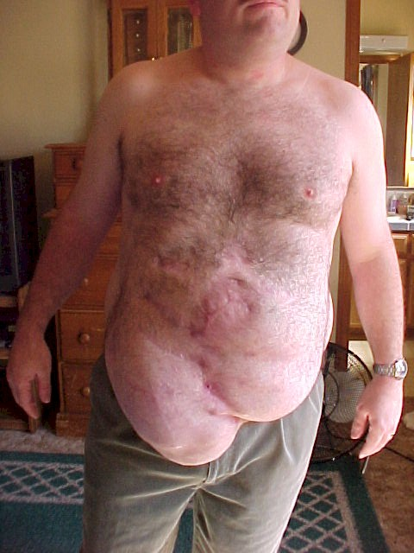

Slide 5
Hernias by themselves usually are harmless, but nearly all have a potential risk of having their blood supply cut off (becoming strangulated).
If the blood supply is cut off at the hernia opening in the abdominal wall, it becomes a medical and surgical emergency.

Slide 6
Constituents of hernia
Hernial ring
Hernial sac
Hernial contents

Slide 7
Classification or characteristics of hernias
Based on Location :
  External hernia – Inguinal hernia, Umbilical hernia.
  Internal Hernia – Diaphragmatic hernia.
II. Based on functional alterations:
  Reducible
  Irreducible – Incarcerated hernia, strangulated hernia

Slide 8
Cont….
III. Based on hernial contents
i) Enterocoele – intestines
ii) Vesiculocoele – urinary bladder
IV. Based on cause
i) Congenital – anatomical variations
ii) Acquired – trauma

Slide 9
CONT….
V. Complete and Incomplete hernia.
VI. Intraparietal hernia.
VII. Bilateral or Unilateral hernia.

Slide 10
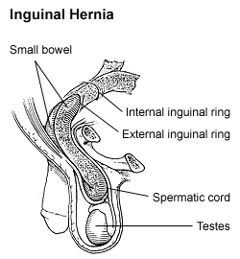
TYPES OF HERNIAS
Inguinal (groin) hernia
Direct inguinal hernia
Indirect inguinal hernia

Slide 11
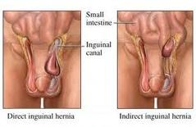

Slide 12
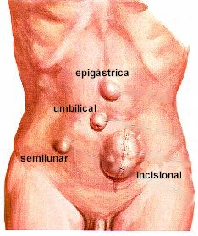
Femoral hernia
Umbilical hernia
Incisional hernia
Spigelian hernia
Obturator hernia
Epigastric hernia
Diaphragmatic hernia

Slide 13
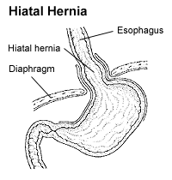
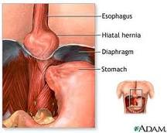
Diaphragmatic hernia

Slide 14
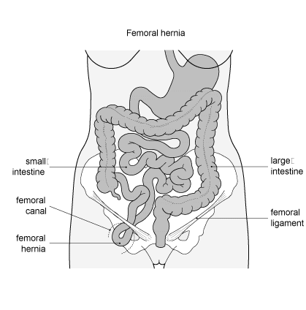

Slide 15
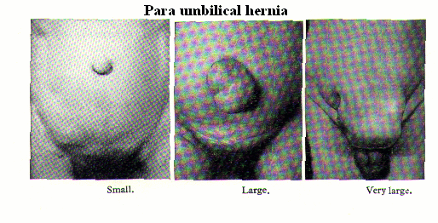

Slide 16
OTHER HERNIAS
Littre's hernia.
Lumbar hernia (Bleichner's Hernia)
Petit's hernia + Grynfeltt's hernia
Maydl hernia
Pantaloon hernia
Paraumbilical hernia
Perineal hernia

Slide 17
CONT….
Properitoneal hernia
Richter's hernia
Sciatic hernia
Sports hernia
Velpeau hernia
Amyand's Hernia

Slide 18
ETIOLOGY
Obesity.
Heavy lifting.
Coughing.
Straining during a bowel movement or urination.
Chronic lung disease.
Fluid in the abdominal cavity.
A family history.
If muscles are weakened due to poor nutrition, smoking, and overexertion, hernias are more likely to occur.

Slide 19
SIGNS AND SYMPTOMS
Reducible hernia.
Irreducible hernia.
Strangulated hernia.
Others.

Slide 20
PROGRESS OF THE HERNIA
obstruction
strangulation
DYSFUNCTION

Slide 21
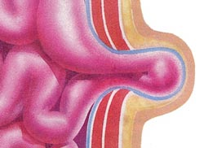
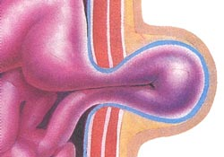
Incarcerated
Strangulated

Slide 22
DIAGNOSTIC MEASURES
A. History collection
B. Physical examination
C. Lab investigations
D. Cough test
E. Valsalva’s maneuver
F. Imaging studies (MDCT)

Slide 23
COMPLICATIONS
• Inflammation
• Irreducibility
• Obstruction of any lumen, such as bowel obstruction in intestinal hernias
• Strangulation
• Hydrocele of the hernial sac
• Haemorrhage
• Autoimmune problems

Slide 24
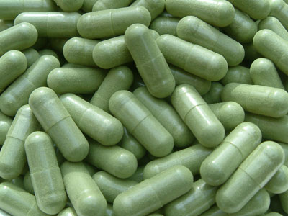
MEDICAL MANAGEMENT
REDUCIBLE HERNIA
IRREDUCIBLE HERNIA

Slide 25
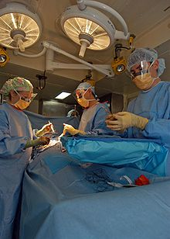
SURGICAL MANAGEMENT

Slide 26
Types of hernia surgeries
Herniotomy.
Herniorraphy.
Hernioplasty.
Laparoscopic surgery.
Gastropexy.

Slide 27
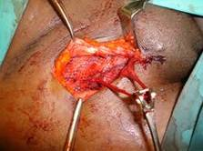

Slide 28
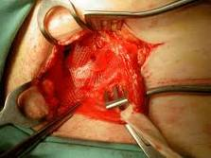

Slide 29
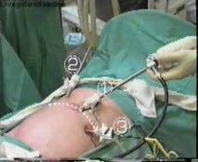

Slide 30
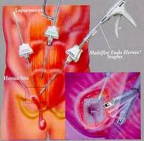

Slide 31
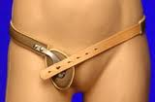
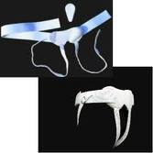
HERNIA TRUSS

Slide 32
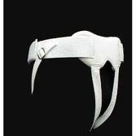
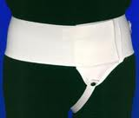

Slide 33
NURSING MANAGEMENT
1. Acute pain related to the strangulation of the herniated part and surgical interventions.
2. Imbalanced nutrition, less than body requirement related to nausea, vomiting, and pain.
3. Fluid volume deficit related to presence of hemorrahge, excessive vomiting or fliud accumulation secondary to development of complications.
4. Activity intolerance related to severe pain.

Slide 34
5. Disturbed body image related to protrusion of the body parts through the hernial sac.
6. Anxiety related to severe pain, protrusion of the herniated sac, and outcome of treatment modalities.
7. Deficient knowledge regarding the care to be taken, cause of the disease and the various complications that can arise.
8. Risk for complications, hemorrhage and life threatening situation related to untreated herniated sac.
9. Risk for infection related to protrusion of the body parts to the outside world.

Slide 35
ALLIED SCIENCES
Herbal medicine.
Aromatherapy.
Accupressure.
Ayurvedic therapy.

Slide 36
JOURNAL ABSTRACT
LAPAROSCOPIC HERNIA REPAIR
Vs
OPEN HERNIA REPAIR.

Slide 37
THEORY APPLICATION
CARE
CURE
CORE

Slide 38

THANK YOU

