Slide 1
Menstrual Cycle
Prepared By,
Ms. Bincy Cherian
Asst.prof
College of Nursing Kishtwar

Slide 2
Biology and the Menstrual Cycle
• Menstrual cycle is regulated by fluctuating
levels of sex hormones
These hormones produce certain changes in
the ovaries and uterus
Humans are nearly unique among species in
having a menstrual cycle
Other species of mammals have estrous
cycles

Slide 3
Basic terms
Endometrium: Lining of the uterus
Oocyte: Developing reproductive cell
Ovum: Mature egg after meiosis
Menopause: Last menstrual cycle, afterwhich egg production stops

Slide 4
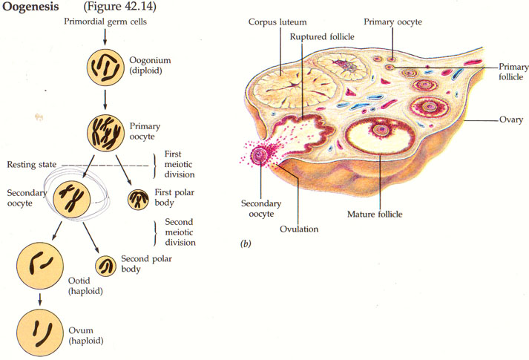

Slide 5
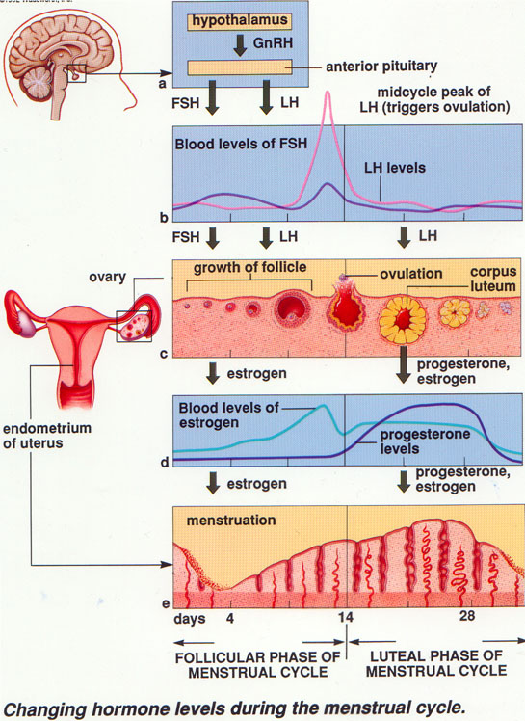

Slide 6
4 phases of menstrual cycle
Menstrual flow
Proliferative
Ovulation
Luteal

Slide 7
During which days of the cycle is FSH at its lowest?
FSH: follicle stimulating hormones is at its lowest during the last days of the cycle

Slide 8
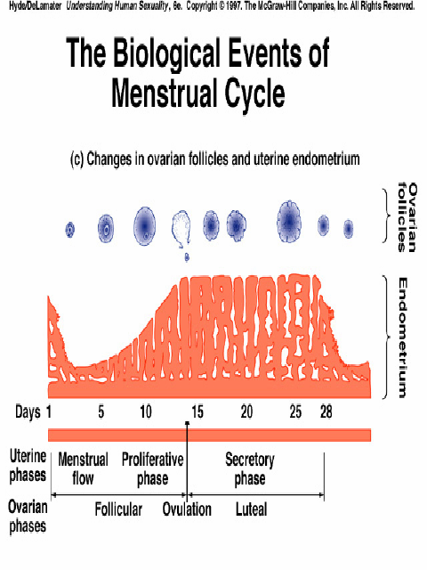
When FSH levels are low what is the size of the follicle
It is shrinking and disappearing while a new set is growing

Slide 9
What is happening to estrogen during the follicle phase?
It dips then rises
In response the uterus lining dips then rises

Slide 10
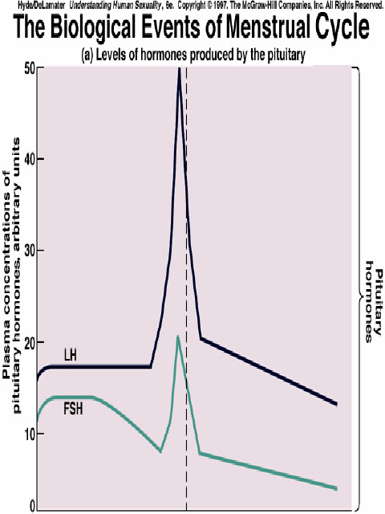
Ovulation
Day 14 of the cycle usually marks an event called ovulation
follicle ruptures open and releases the ripened egg
Pituitary hormones: LH and FSH are peaking
Estrogen is also released from follicle

Slide 11
Hormones and What Happens in the Ovaries
• Luteal phase - after releasing an egg, the follicle turns into the corpus luteum
– The corpus luteum manufactures progesterone
• Menstruation - shedding of the inner lining of the uterus

Slide 12
Length and Timing of the Cycle
Normal menstrual cycle = 20 to 36 to 40 days;
average is about 28 days
– Menstruation begins on day 1 and continues until about
day 4 or 5
– Follicular phase extends from about day 5 to about day
13
– Ovulation occurs on day 14
– Luteal phase extends from day 15 to the end of the
cycle, day 28

Slide 13
Other Cyclic Changes
Two other physiological processes fluctuate
with the menstrual cycle:
– The cervical mucus cycle
– The basal body temperature cycle

Slide 14
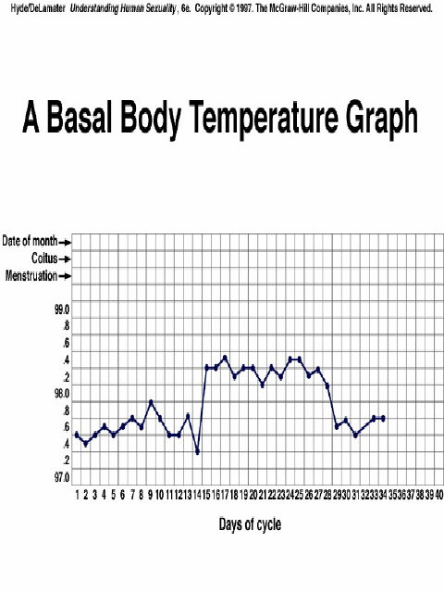

Slide 15
Fluctuations in Performance
• Research on intellectual or athletic
performance generally shows no
fluctuations over the cycle
• Research on academic performance,
problem solving, memory, or creative
thinking shows no fluctuations over the
cycle

Slide 16
What Causes the Fluctuations in Mood
Biological factors
– Fluctuations in levels of hormones
• Environmental factors
– Menstrual taboos and cultural expectations

Slide 17
Cycles in Men
One study found evidence of behavioral
cycles in men
• Another study identified that high
testosterone levels were correlated with
depression
• Other researchers have found cycles in
men’s emotional states

