Slide 1
NUTRITION
Presented by,
Ajith K K
Asst. Professor
College Of Nursing Kishtwar

Slide 2

What Is Nutrition?
The study of how your body uses the food that you eat.

Slide 3
What is a Nutrient
A nutrient is a chemical substance in food that helps maintain the body. Some provide energy. All help build cells and tissues, regulate bodily processes such as breathing. No single food supplies all the nutrients the body needs to function.

Slide 4
The six Classifications of Nutrients
Vitamins
Minerals
Water
Protein
Carbohydrates
Sugars
Starches
Fats
Cellulose

Slide 5

Nutrients that have Calories:
Proteins
Carbohydrates
Fats

Slide 6



Definition of a Calorie:
A unit of measure for energy in food

Slide 7
Calories per gram:
Protein 1 Gram = 4 calories
Carbohydrates 1 Gram = 4 calories
Fat 1 Gram = 9 calories

Slide 8






Variables which affect nutrient needs:
1. Age
2. Gender
3. Activity Level
4. Climate
5. Health
6. State of nutrition

Slide 9
Ten U.S. Dietary Guidelines:
Aim for Fitness
1. Aim for a healthy weight

Slide 10
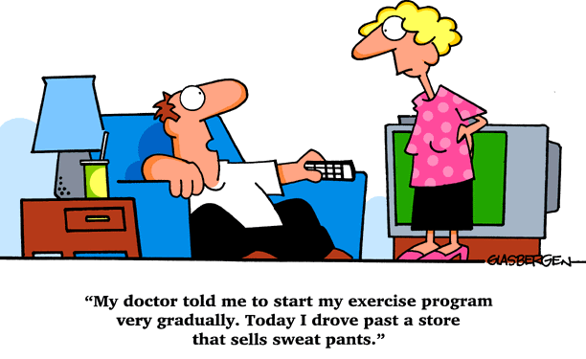
2. Be physically active each day

Slide 11
Build a Healthy Base
3. Let the pyramid guide your choices
4. Choose a variety of grains daily, especially whole grains
5. Choose a variety of fruits and vegetables daily.
6. Keep food safe to eat.

Slide 12
Choose Sensibly
7. Choose a diet that is low in saturated fat and cholesterol and moderate in total fat
8. Choose beverages and foods to moderate your intake of sugars
9. Choose and prepare food with less salt
10. If you drink alcoholic beverages do so in moderation

Slide 13
Thank You!!!

