Slide 1
Personality Assessment Methods
Presented By,
Ms. Mariya Oliver
Asst. Professor
College of Nursing Kishtwar

Slide 2
Interview Method
Interview is defined as a face – to – face conversation carried on with some basic goals.
Two types:
Structureed Interview
Unstructured Interview

Slide 3
Interview Method (Cont)
Seven – Point Plan.
Physical characteristic or abilities.
Attainments – Education, personal and professional background.
Overall general ability
Special aptitude.
Interests.
Personality attributes.
Aspirations and goals.

Slide 4
Interview Method (Cont)
Advantages
It is highly flexible tool.
It can be used for a wide range of people.
Body language can be observed in addition to what is said.
Disadvantages
Highly subjective.
Time consuming
Requires trained personnel.

Slide 5
Personality Inventories
A personality inventory is a printed form containing statements, questions or adjectives which apply to human behaviour.

Slide 6
Personality Inventories (Cont)
Minnesota Multipahsic Personality Inventory.
This test asks for answers of “True” or “False” or “Cannot say” to 550 statements about different personality traits such as attitudes, emotional reactions, physical and psychological symptoms.
The answers are quantitatively measured and personality assessment is done based on the score.

Slide 7
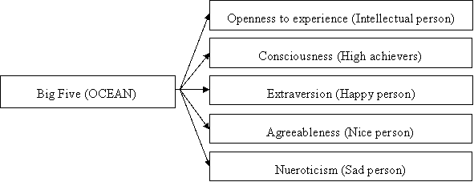
Personality Inventories (Cont)
Big Five Personality Inventory.

Slide 8
Personality Inventories (Cont)
Eysenck Personality Inventory
The dimensions of this inventory are as follows:
Extroversion – Introversion.
Neuroticism – Stability
The test may take 15 – 20 minutes and consists of 57 “yes” or “no” questions. There is no right or wrong answer, the subject has to give an honest opinion.

Slide 9
Personality Inventories (Cont)
Cattell’s 16 factory Personality Inventory.
Abstractedness: Imaginative versus practical
Apprehensions: Worried versus confident
Dominance: Forceful versus submissive
Emotional Stability: Clam versus high strung
Liveliness: Spontaneous versus restrained.
Openness to Change: Flexible versus attached to the familiar.
Perfectionism: Controlled versus undisciplined.
Privateness: Discreet versus open

Slide 10
Personality Inventories (Cont)
Cattell’s 16 factory Personality Inventory.
Reasoning: Abstract versus concrete
Rule – Consciousness: Conforming versus non – conforming
Self – Reliance: Self – sufficient versus dependent
Sensitivity: Tender – hearted versus tough – minded
Social Boldness: Uninhibited versus shy
Tension: Impatient versus relaxed.
Vigilance: Suspicious versus trusting
Warmth: Outgoing versus reserved

Slide 11
Projective Techniques
Rorschach Inkblot Test
It is developed by Herman Rorschach in 1921.
This test involves ten cards containing inkblots show to the subject one at a time in a prescribed order – five black and white, two red or grey and three colour cards.
Unveil hidden thought process
The subject is instructed to state whatever he/she sees in them or whatever they bring to mind. Based on subject’s statement, assumptions are made on the nature of personality.

Slide 12
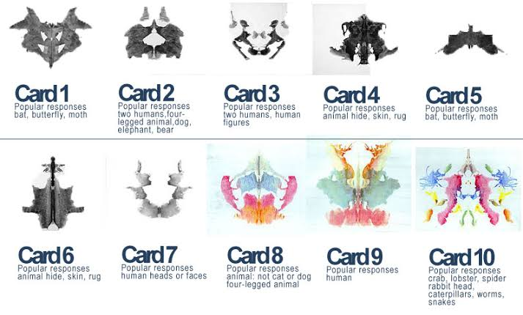

Slide 13
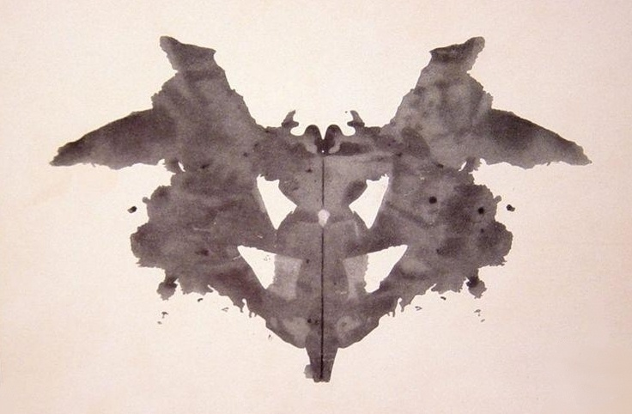

Slide 14
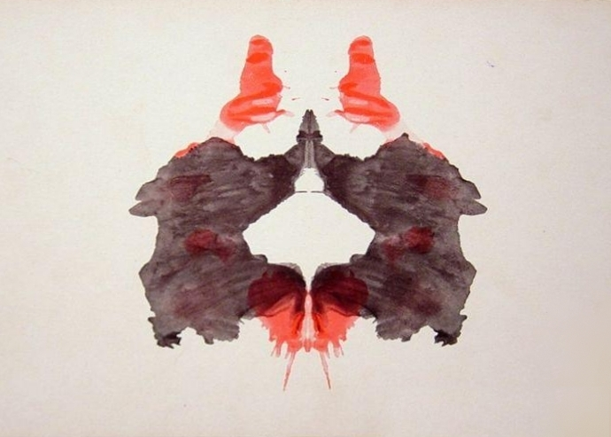

Slide 15
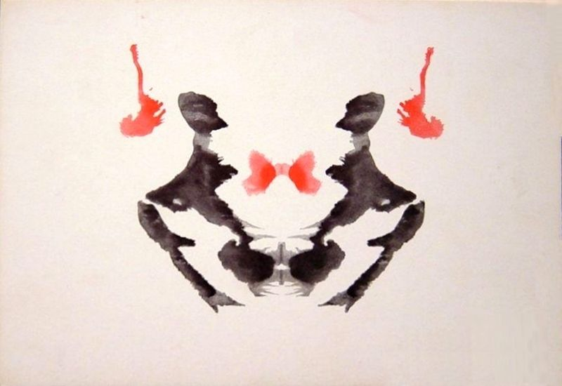

Slide 16
Personality Inventories
Thematic Appreception Test
Developed by C.D.Morgan and Henry A Murray in 1935
The assumption underlying the Thematic Appreception Test is that the meaning which we see in a picture reveals something of our past experience, feelings, attitudes and motives.
In this test, the subject is shown ambiguous pictures and asked to make up a story for each one. There are 30 – gray scale pictures and one blank for elicitation of stories.

Slide 17
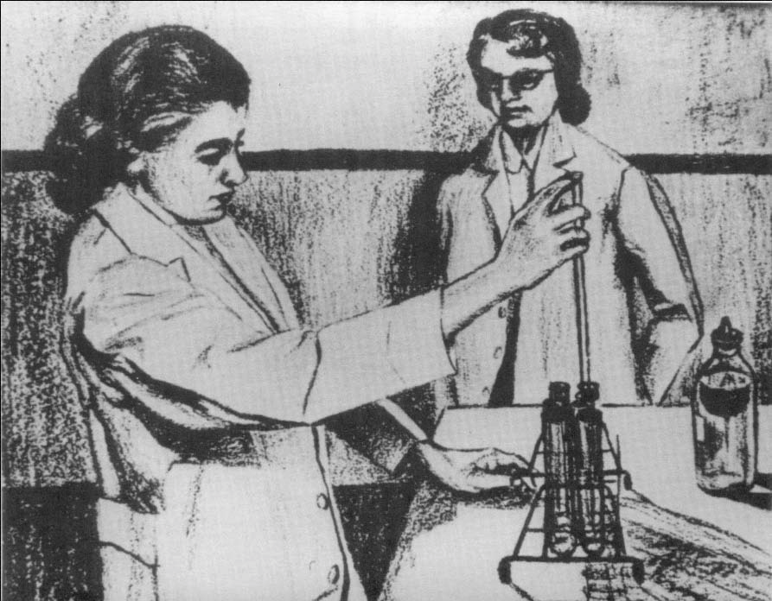

Slide 18
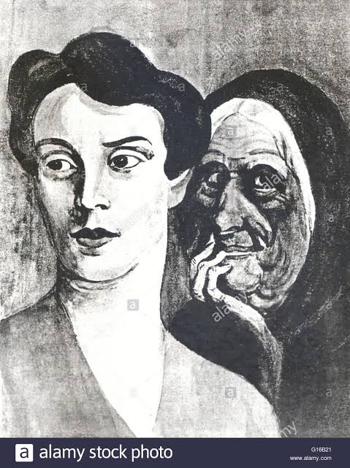

Slide 19
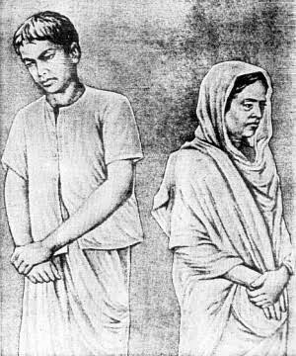

Slide 21
Personality Inventories
Word Association Test
In word association test, the subject is informed that the examiner would utter a series of words, one word at a time and subject should immediately utter the first word that comes to his mind.
There are no right or wrong answers.
Based on the subject’s response the examiner evaluates the individual’s personality.

Slide 23
Personality Inventories
Sentence Completion Test
Here a number of incomplete sentences are given and the subject is required to complete them as to how he/she feels.
The responses are analyzed for indications of one’s personality.
The test includes the information about wishes, desires, likes, dislikes, fears and locus of control..

Slide 24
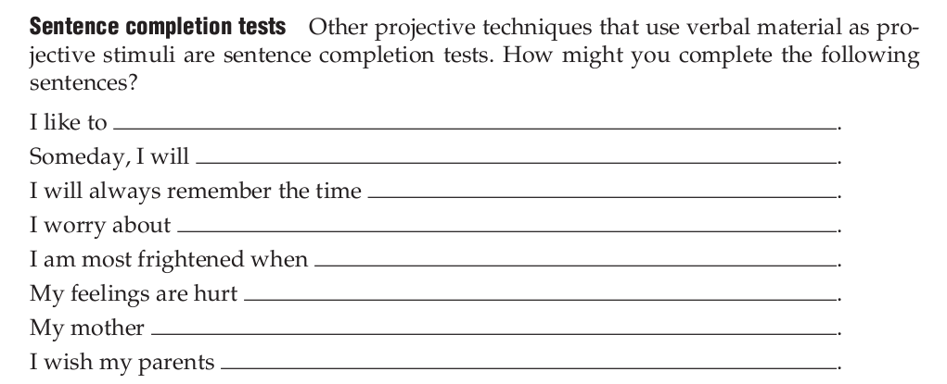

Slide 26
Personality Inventories
Situational Test
This consists of certain real life situations where the subjects have to perform certain given activities.
Subject’s performance and behaviour with respect to such situations helps us to understand his/her personality.
In this test, the subject’s behaviour is evaluated by some trained person.

Slide 27
Advantages and Disadvantages of Personality Inventories
Advantages
Helps assess personality.
Helps in career choices.
Helps in recruitment process.
Disadvantages
It varies from person to person.
Subject can fake at being “good” or “bad”
There are chances of random responding.

Slide 28
Thank you

