Slide 1
Principles of Perception
Presented by:
Ms. Mariya Oliver
Asst. Professor
College of Nursing Kishtwar

Slide 2
1. Principle of Figure – Ground Relationship
According to this principle, a figure is perceived in relationship to its background. The perception of the object or figure is done in terms of colour, size, shape and intensity, etc. of either the figure or the background.

Slide 3


Slide 4
2. Principle of Closure
According to principle of closure, while confronting an incomplete pattern on e tends to complete or close the pattern or fill in sensory gaps and perceive it as a meaningful whole.

Slide 5


Slide 6


Slide 7
3. Principle of Grouping
This principle refers to a tendency to perceive stimuli in some organized meaningful patterns by grouping them on basis like similarity, proximity and continuity.

Slide 8
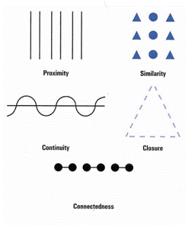
a) Similarity

Slide 9
b) Continuity

Slide 10
c) Proximity

Slide 11
4. Principle of Simplicity
We perceive the simplest possible pattern because they enable the perceiver to perceive the whole from some of its parts.

Slide 12
5. Principle of Contour
A contour is said to be a boundary between a figure and its ground. The degree of the equality of this contour separating the figure from the ground is responsible for enabling us to organize stimuli or objects into meaningful patterns.

Slide 13
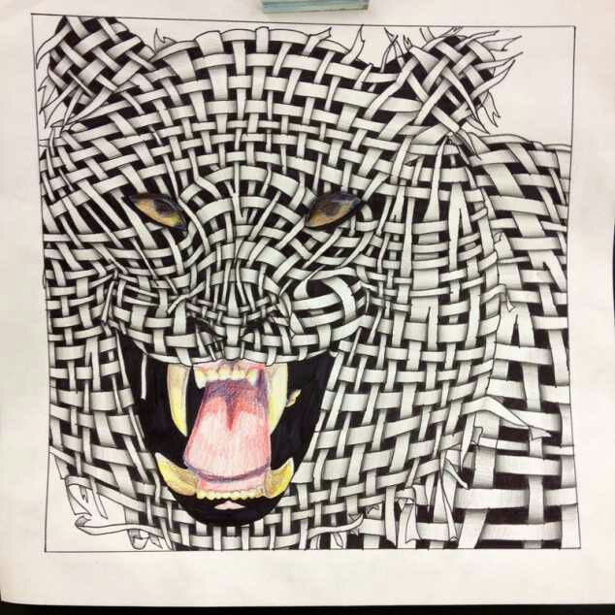

Slide 14
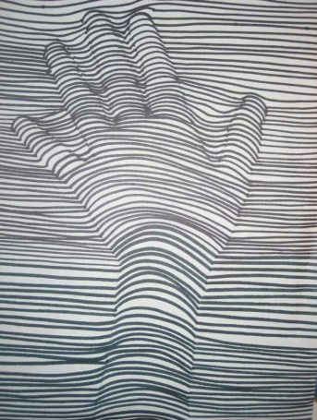

Slide 15
6. Principle of Context
Perceptual organization is also governed by the principle of context, ie, an examiner may award higher marks to the same answer book in a pleasant context than in an unpleasant one.

Slide 16
7. Principle of Contrast
Perceptual organization is very much affected through contrast effects as the stimuli that are in sharp contrast to nearby stimuli may draw our maximum attention and carry different perceptual affects.

Slide 17
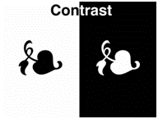

Slide 18
8. Principle of Adaptability
The perceptual organization for some stimuli depends upon the adaptability of the perceiver to perceive similar stimuli.

Slide 19


