Slide 1
Psychological Assessment And Tests
By
Mariya Oliver
Asst. Professor
College of Nursing Kishtwar

Slide 2
Definitions
Psychological Assessment:
It refers to the types of tests that we use to help identify strengths and areas for growth that affects one’s emotional, personal and professional development or adjustment.

Slide 3
Psychological Assessment
The gathering and integrating of psychological data for psychological evaluation, through the use of tests, interviews, case studies, behavioral observation, and specially designed apparatuses and measurement procedures.

Slide 4
Psychological test:
A psychological test is an objective and standardized measure of an individual's mental and/or behavioral characteristics.
These are measurement devices or techniques used to quantify behavior, to aid in the understanding and prediction of behavior.

Slide 5
Characteristics Of Psychological Tests
Standardization:
It refers to the consistency or uniformity of the conditions and procedures for administering a test.
Objectivity:
It refers primarily to the scoring of the test results. The scoring process must be free of subjective judgement or bias on the part of the scores.

Slide 6
Characteristics (Cont..)
Test norms:
It is the information used to rank scores in relation to other scores on the test. To interpret the results of a psychological test, a frame of reference or point of comparison must be made. This is done by test norms.
Usability

Slide 7
Characteristics (Cont..)
Reliability:
It refers to the consistency of the result of the test. Repeating the test has to reveal the same consistent results either with the same or different evaluator of the test.
Validity:
It refers to the accuracy in the measurement of the test. It means that the test should measure what it is supposed to measure.

Slide 8
Principles Of Psychological Tests
Psychological tests should have three components which makes it possible for anybody to administer it anywhere, anytime. These are :
Standard.
Content.
Process.

Slide 9
Principles (Cont..)
The tests should have norms to compare an individual test score to the score of a known group, who have taken the test.
These tests are of high technical quality prepared by experts, pretested and selected on the basis of difficulty and relationship to a clearly defined rigid set of specifications.
Psychological tests are always standardized so that it can be used by different users.

Slide 10
Principles (Cont..)
The directions for administering scores are precisely stated, so that the test can done by anyone.
A test manual and other accessory materials are provided as a guide for administration, scoring, evaluating its technical qualities and for interpreting and using the results.

Slide 11
Purposes Of Psychological Tests
To measure and observe a client’s behaviour to formulate a diagnosis & guide treatment.
To perform scientific research on human behaviour.
To assess the deviation from normal mental health status.

Slide 12
Purpose (Cont..)
To identify one’s strength or areas of growth that affect one’s emotional, personal and professional development.
To assess the academic achievement and developmental delay in children.
To assess the different mental abilities and attributes.

Slide 13
Development Of Psychological Tests
Analysis of the situation in which the tested skills are to be used.
Tentative selection of the test items.
Development of a standardized method of administration and scoring.
Administration of all test items to a large representative group of individual.
Final selection of items.
Evaluation of the final test.

Slide 14
Classification Of Psychological Tests
Based on construction and administration
Individual and group tests.
Speed and power tests.
Computer – assisted tests.
Paper-pencil and performance. tests.

Slide 15
Based on knowledge, skills and abilities.
Achievement test
Aptitude test
Intelligence test
Interest test
Neuropsychological test
Personality test
Attitude test

Slide 16
Individual And Group Tests
Individual tests are designed to be administered, to one person at a time.
Eg: Rorschach inkblot test.
Group tests are designed to be administered to a large number of people at the same time.
Eg: Achievement test.

Slide 17
Speed And Power Tests
In a speed test the scope of the questions is limited and the methods you need to use to answer them is clear. Speed test are concerned with how many questions you can answer correctly in the allotted time
Eg: Sentence completion test with time limit. Or MCQs for entrance exams.

Slide 18
A power test on the other hand will present a smaller number of more complex questions. The methods you need to use to answer these questions are not obvious, and working out how to answer the question is the difficult part. Here there is no limit in the time.
Eg: Sentence completion test.

Slide 19
Computerized – Assisted Tests
In this test, we use computers for administering tests to a large group. Here an individual’s response determines the level of difficulty of succeeding items.
Here, the computer programme begins with a question of average difficulty and if the individual answers it correctly, it proceeds to questions of greater difficulty. If not it asks less difficult question.

Slide 20
Paper-Pencil And Performance Tests
Paper – pencil tests are in printed form. Here answers are recorded on a standard answer sheet.
Eg: University theory exams.
Performance tests assess complex skills, such as word processing or mechanical abilities.
Eg: University Practical exams.

Slide 21
Achievement Tests
These are used in educational or employment settings and they attempt to measure the achieved knowledge such as mathematics or spelling.
Eg: Semester examinations.

Slide 22
Aptitude Tests
These tests measure specific abilities such as mechanical or clerical skills. These include measurement of perceptual speed and accuracy, attention to detail, the capacity to visualize and manipulate objects in space, principles of mechanical operation, ability to operate computers, etc.
Eg: General aptitude test battery (GATB),
Differential aptitude test (DAT) C:\Users\dell\Downloads\Documents\DATS_EXPLAINED.pdf

Slide 23
Intelligence Tests
These tests attempt to measure intelligence, i.e, basic ability to understand the world around.
Eg: Standford – Binet Scale, Wechsler Adult Intelligence Scale, Army Alpha Test, Army General Classification Test.
C:\Users\dell\Downloads\Documents\WAISIV2_6_08.pdf

Slide 24
Stanford-Binet Intelligence Scales.
Initially developed by Alfred Binet and Theodore Simon.
Currently in its 5th edition (SB5) which was revised by Lewis M. Terman.
It measures a wide variety of verbal and nonverbal skills and consists of questions and short tasks arranged from easy to difficult.
It is a cognitive ability and intelligence test that is used to diagnose developmental or intellectual deficiencies in young children.

Slide 25
SB5 (cont)
Its tests are divided into:
Knowledge.
Quantitative reasoning.
Visual-spatial processing.
Working memory.
Fluid reasoning.

Slide 26
Subtests And Factors (SB5)
Fluid Reasoning | Knowledge | Quantitative Reasoning | Visual-Spatial Processing | Working Memory
Early reasoning | Vocabulary | Non-verbal quantitative reasoning (non-verbal) | Form board and form patterns (non-verbal) | Delayed response (non-verbal)
Verbal absurdities | Procedural knowledge (non-verbal) | Verbal quantitative reasoning | Position and direction | Block span (non-verbal)
Verbal analogies | Picture absurdities (non-verbal) |  |  | Memory for sentences
Object series matrices (non-verbal) |  |  |  | Last word

Slide 27
Classification of IQ (SB5)
IQ Range | IQ Classification
145–160 | Very gifted or highly advanced
130–144 | Gifted or very advanced
120–129 | Superior
110–119 | High average
90–109 | Average
80–89 | Low average
70–79 | Borderline impaired or delayed
55–69 | Mildly impaired or delayed
40–54 | Moderately impaired or delayed

Slide 28
Present Use (SB5)
It has equal balance of verbal and non-verbal content in the test.
It is more animated than the other tasks, providing the test-takers with more colourful artwork, toys and manipulatives.
This test is useful in assessing the intellectual capabilities of people ranging from young children all the way to young adults.

Slide 29
Present Use (SB5)
Clinical and neuropsychological assessment.
Educational placement, compensation evaluations.
Career assessment
Adult neuropsychological treatment
Forensics and research on aptitude.

Slide 30
Wechsler Adult Intelligence
Scale (WAIS)
Developed by David Wechsler.
Currently in its 4th edition (WAIS-IV)
It is the most widely used IQ test, for both adults and older adolescents, in the world.
Four index scores are:
Verbal Comprehension Index.
Perceptual Reasoning Index.
Working Memory Index.
Processing Speed Index.

Slide 31
Subtests And Factors (WAIS-IV)
Verbal Comprehension | Perceptual Reasoning | Working Memory | Processing Speed
Similarities | Block Design | Digit Span | Symbol Search
Vocabulary | Matrix Reasoning | Arithmetic | Coding
Information | Visual Puzzles | Letter-Number Sequencing | Cancellation
Comprehension | Picture Completion
 | Figure Weights

Slide 34
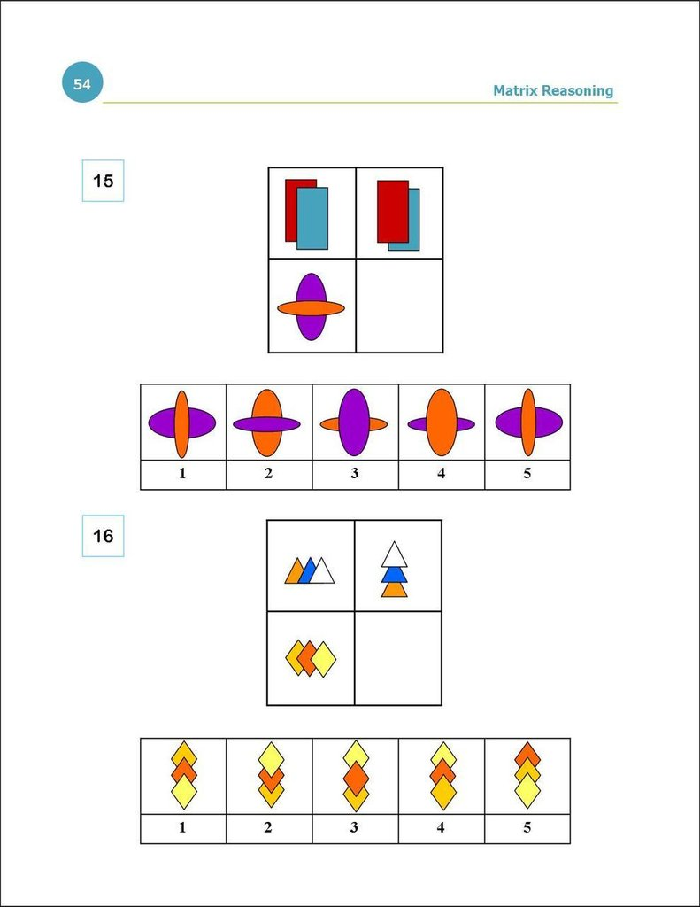

Slide 35
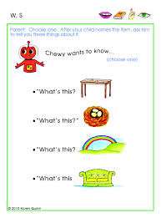

Slide 36
Interest Tests
These psychological tests are meant to assess a person’s interests and preferences.
These are mainly used in career counseling.
Eg: Interest Inventory.
C:\Users\dell\Downloads\Documents\StudentInterestSurvey-English.pdf

Slide 37
Neuropsychological Tests
These tests measure deficits in cognitive functioning (ability to think, speak, reason, etc.)
These deficits may result from some sort of brain damage such as stroke or a brain injury.
Eg: Cambridge Neuropsychological Test Auomated Battery(CANTAB), Wechsler Adult Memory Scale.
C:\Users\dell\Downloads\Documents\CANTAB test descriptions by function.pdf

Slide 38
Occupational Tests
They attempt to match interests with the interests of persons in known careers, i.e, to the interest of person with present job or work.
Eg: McQuaig Occupational Test.

Slide 39
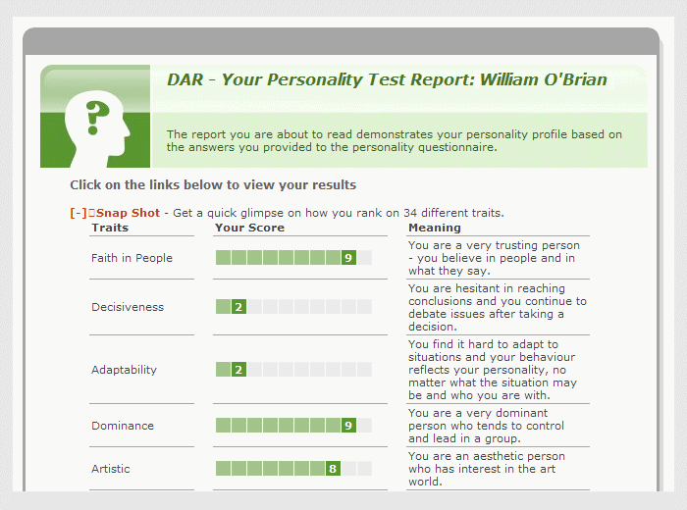

Slide 40
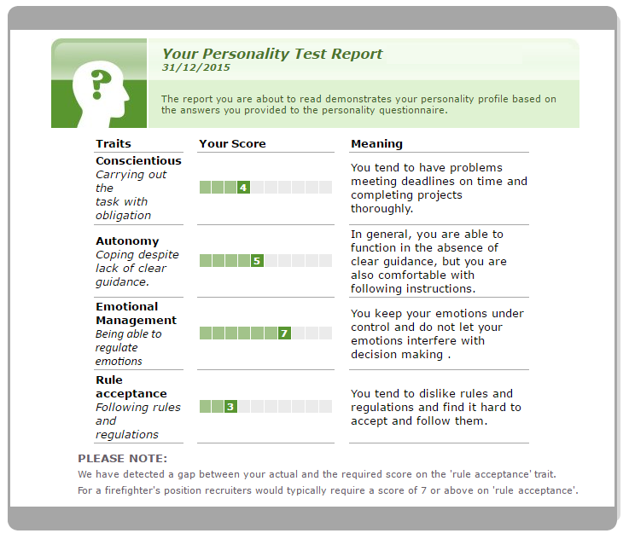

Slide 41
Personality Tests
These are used to assess the basic personality style.
Eg: Minnesota Multiphasic Personality Inventory (MMPI), Rorschach inkblot test.

Slide 43
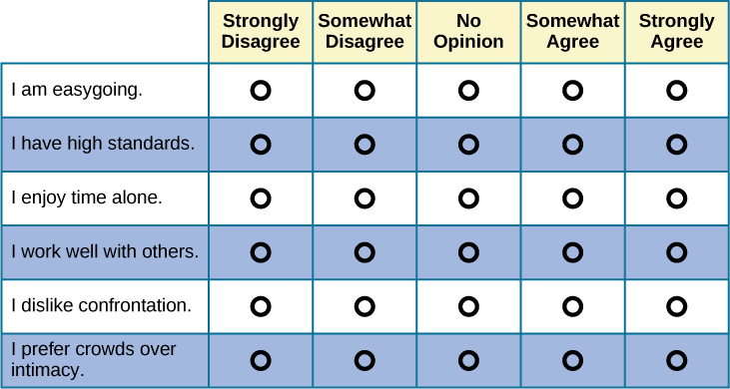

Slide 44
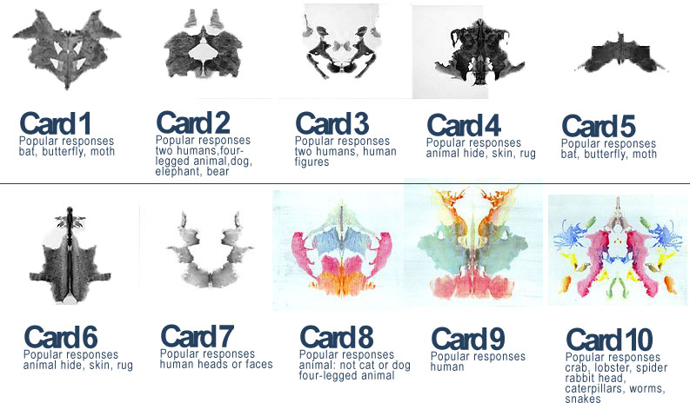

Slide 46
Specific Clinical Tests
These attempt to measure specific clinical matters, such as current level of anxiety and depression.
Eg: Hamilton rating scale for depression, Brief psychiatric rating scale.

Slide 47
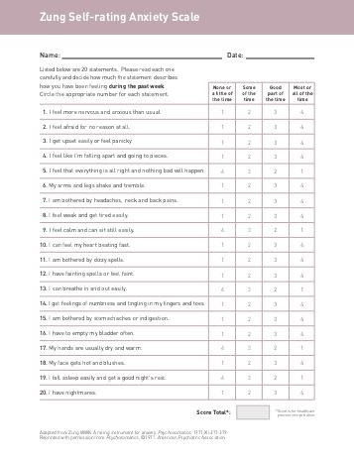

Slide 48
Uses Of Psy. Tests
It is easier to get information from tests than by clinical interview.
The information form tests is more scientifically consistent than the information from a clinical interview.
They assist in diagnosis.
They assist in the formulation of psychopathology and identification of areas of stress and conflicts. (Eg: Thematic Apperception Test)

Slide 49
Uses Of Psy. Tests (Cont)
They help to determine the nature of deficits present. (Cognitive Neuropsychological Assessments)
They help in assessing severity of psychopathology and response to treatment.
They help to assess the general cognitive characteristics of an individual, i.e. their intelligence, personality, mood, etc.

Slide 50
Uses Of Psy. Tests (Cont)
These tests can be used in forensic evaluations, litigation, family court issues or criminal charges.
These tests help in assessing the level of functioning or disability, help in direct treatment and assess treatment outcomes.

Slide 51
Limitations Of Psy. Tests
No test is completely valid or reliable, because the human psyche is too complicated. Hence there is uncertainty about a case even after extensive testing.
Many applicants experience considerable test anxiety.
Negative attitudes towards psychological tests may lower applicant’s motivation to perform which will reduce the validity of the test.
Administration and interpretation is done only by qualified psychologists.

Slide 52
Role of a nurse
Nurses should become familiar with many standardized psychological tests that are available to enhance each stage of the nursing process.
These tests will help in providing care and provide measurable indicators of treatment outcomes.
The nurse should have knowledge about all the psychological test.
The nurse should reassure about safety and confidentiality.

