Slide 1
THEORIES OF MOTIVATION
Presented By:
Ms Mariya Oliver
Asst. Professor
College of Nursing Kishtwar

Slide 2
1. Instinct Theory Of Motivation
According to this theory, innate biological instincts guide behaviour. William James created a list of human instincts that included attachment, play, shame, anger, fear, shyness, modesty and love.
Has three aspects:
Cognitive (Knowing)
Affective ( Feeling)
Conative (Acting)

Slide 3
2. Drive Theory Of Motivation
Also called “Push Theory of Motivation”
This theory was developed by Clark Leonard Hull in 1943. According to this theory, behaviour is guided by biological needs and learned ways of reducing drives arising from those needs.

Slide 4
Driving stage
Goal – directed behaviour
Achievement of goal
Relief

Slide 5
3. Arousal Theory Of Motivation
Arousal is the level of alertness, wakefulness and activation caused by activity in the central nervous system.
According to this theory, people seek to maintain an optimal level of physiological arousal, which differs from person – to – person.
We are motivated to maintain an optimal level of arousal, although this level can vary based on the individual or the situation.

Slide 6
4. Incentive Theory Of Motivation
Also called as “Pull Theory of Motivation”
Proposed by Thorndike, Pavlov, Watson, and BF Skinner
This theory suggests that people are motivated to do things because of external rewards.

Slide 7
5. Content Based Theories

Slide 8
A. Maslow’s Hierarchy Of Needs
Self Actualization
Self Esteem
Love and Belonging
Safety and Security
Physiological Needs

Slide 9
B. Alderfer’s Existence, Relatedness And Growth Theory
Existence Needs
Related Needs
Growth Needs

Slide 10
C. Herzberg’s Two Factor Theory

Slide 11
D. McClelland Achievement Theory
Power Motive
Affiliation Motive
Achievement Motive

Slide 12
E. Bandura’s Self – Efficacy Theory
Self - Efficacy
Protective Motivation
Adaptive Changes
Defensive Motivation
Maladaptive Changes
Perceived Efficacy
Perceived Threat

Slide 13
6. Process Based Theories

Slide 14
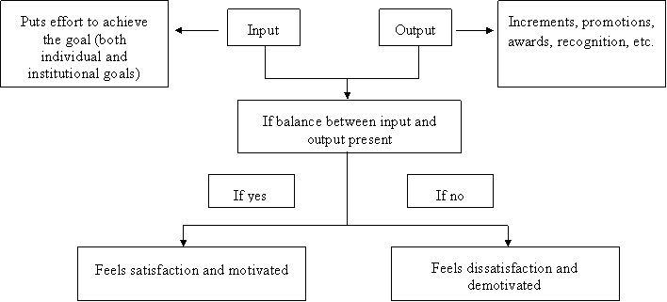
A. Adam’s Equity Theory

Slide 15
B. Locke’s Goal Setting Theory
Mastery goals
Performance goals
Goals should be:
S – Specific
M – Measurable
A – Attainable
R – Relevant, Realistic
T – Time bound

Slide 16
C. Vroom’s Expectancy Theory

Slide 17
Thank you

