Slide 1
THE UREA CYCLE
Prepared By,
Mrs. Lincy Joseph
Asst. Prof
College of Nursing Kishtwar

Slide 2
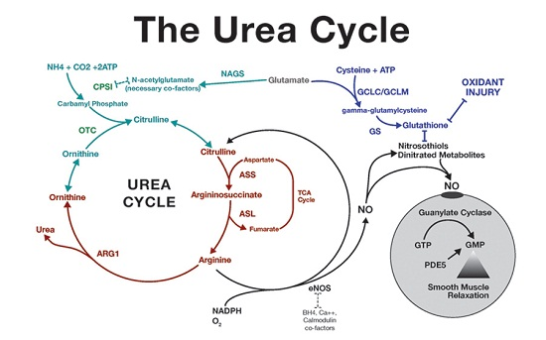

Slide 3
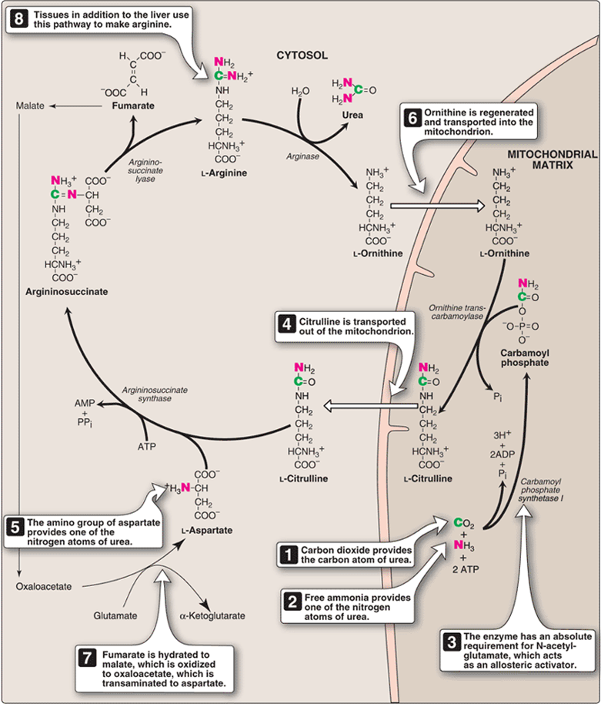

Slide 4
